Slide 1
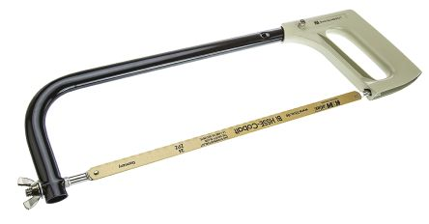
Hacksaw
Hacksaw
Lesson Launch:
Lesson Launch:
1) List 3 Health and safety rules:
1)
2)
3)
1) List 3 Health and safety rules:
1)
2)
3)
(3 marks)
(3 marks)
2) Explain why you can change the blade:
2) Explain why you can change the blade:
(3 marks)
(3 marks)
3) What does ergonomic mean?
3a) Label the ergonomic features on the Hacksaw
3) What does ergonomic mean?
3a) Label the ergonomic features on the Hacksaw
(4 marks)
(4 marks)
Thursday, 3 September 2020

Slide 2
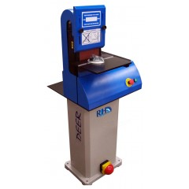
Health and Safety – 6 minutes
Health and Safety – 6 minutes
Lesson Launch:
Lesson Launch:
The picture shows a belt sander
Complete the table below by identifying the hazards and stating the precautions
The picture shows a belt sander
Complete the table below by identifying the hazards and stating the precautions
Hazards | Precaution
Hazards | Precaution
NAME_________________
NAME_________________

Slide 3
Below are a number of Health and Safety Symbols. Write the correct description underneath each one. The descriptions are in random order, at the bottom of the page.
CLOSE FIRE DOOR : OIL :
MOVING PARTS : EXPLOSIVE :
HEAVY OBJECT
WEAR EAR PROTECTION :
NO RUNNING : RADIATION
RISK OF TRAPPING HANDS :
NO SWIMMING : DO NOT FREEZE :
KEEP FROZEN : DO NOT DROP :
WEAR BREATHING APPARATUS :
CORROSIVE : WEAR HARD HAT : SIREN

