Slide 1
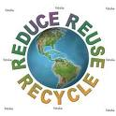
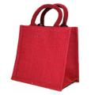
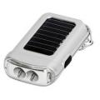
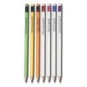
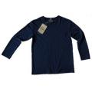
Introducing the Six R’s
GCSE Design and Technology
Notes:
This PPT supports the GCSE Design and Technology specification for England and Wales in all material areas.

Slide 2
Did you know that…..
Only 1 in every 10,0000
products are designed with the environment in mind…
(Edwin Datschefski)
Notes:
It would be good to ask your students why they think that many companies are not too bothered about considering the environment when developing new products.
For more inspirational quotes go Edwin’s website www.biothinking.org.uk

Slide 3
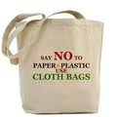
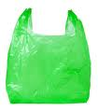
Starter activity: What’s the specification?
Working in small groups - look at the two products that you’ve been given in class (or the bags below).
Make a list on your worksheet of the design specifications that you think the designer followed to design the two products.
Notes:
Teacher’s notes
The worksheet for this activity is available at www.
You could use real life examples of products pairs to match your focus areas or topics. For suggestions of products pair examples and pictures go to our image gallery www.
When the student’s have completed their worksheet, encourage feedback on the specifications they have included. What were the main differences between the two products?

Slide 4
What do you think is the role of designers?
Designers should define their role as agents of good in the world and limit their work to products that are needed and can be made without damage to nature or people.
(Phillip Starck)
Notes:
What do your students think of the quote – do they feel designer’s should be responsible for how their designs impact on the environment and people?
Is it the responsibility of designers to consider the environment when developing new products?
To extend thinking about this question – you could run a whole class belief circle activity, getting the students to decide on their viewpoint on the responsibility of designers.

Slide 5
What are the big sustainability issues for designers?
1. Resource use
We use so much and so many materials.
Many of the products we use daily use materials that are in scarce supply and are non-renewable.
If everyone in the world used as any resources as we do in the UK, we’d need 3 planets to sustain us.
Notes:
There are so many environmental considerations for designers to make throughout the lifecycle of designing a product from material choice, production methods, through to final disposal.
Resource depletion, climate change and impact on people are some of the main issues for students to be aware of.

Slide 6
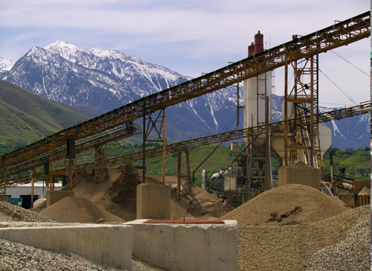
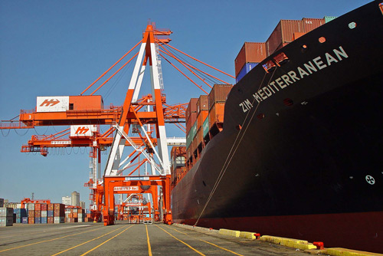
Big issues…
2. Climate Change
Many products use a lot of energy to;
Process materials and produce
Transport
Use and dispose
The energy used throughout the product ‘lifecycle’ releases carbon dioxide, which contributes towards climate change.

Slide 7
Big issue…
3. Impact on people
There are people involved at each stage of the development of a new product.
Make a list of all people who might be involved in the production, use and disposal of:
Who are the people that benefit and who loses out throughout the whole of the product lifecycle?
Non fair trade ice cream
Fair trade ice cream
Notes:
To extend this activity on impact of people – you could do a winners and losers activity.

Slide 8
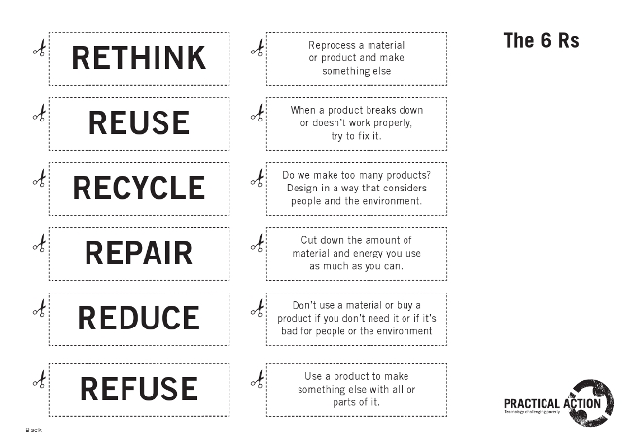
Six R’s
The 6R’s could be a way of helping you think about the reducing the impact of a new product on the environment and people.
Activity
Match the 6R’s on your worksheet to their definitions
Notes:
Activity:
Match the 6 R’s to their definitions. Rethink, Refuse, Reduce, Reuse, Recycle, Repair.
The downloadable worksheet with the 6R’s and definitions is available at www.
After the students have completed their matching activity, ask them to put them in an order of definitions that have the greatest and the least impact on the environment. We suggest they learn the 6R’s in the order presented on the next slide.
You could extend this activity by allowing students to research companies or products that have the 6R thinking embedded within their principles. (see final slide for suggestions)

Slide 9
Check you’ve got them right…
RETHINK: Do we make too many products? Design in a way that considers people and the environment.
REFUSE: Don’t use a material or buy a product if you don’t need it or if it’s bad for people or the environment.
REDUCE: Cut down the amount of material and energy you use as much as you can.
REUSE: Use a product to make something else with all or parts of it.
RECYCLE: Reprocess a material or product and make something else.
REPAIR: When a product breaks down or doesn’t work properly, fix it.

Slide 10
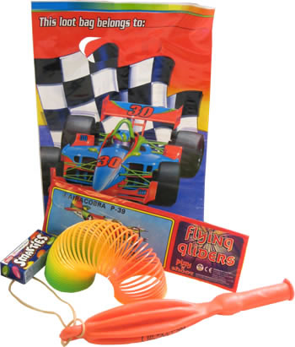
Plenary activity : Using 6 R’s
Look at the party bag and its contents below.
Use the 6R’s to help you redesign it in a way that considers people and the environment.
Notes:
Now that the students have matched the definitions and discussed a possible hierarchy of highest and lowest environment impact.
Final plenary – redesign a product to check their understanding of the application of the 6Rs to redesign a product.

Slide 11
6R’s and party bags
Rethink: What could you do differently? Do we need party bags at all?
Refuse: Are there materials you would choose not to use?
Reduce: Can you reduce the packaging?
Reuse: Can the bag or its contents be used again for another purpose?
Recycle: Have you used materials that area easy to recycle when its finished with?
Repair: It is possible to mend any of it or will it go to landfill if broken?
Notes:
Party bags are a good product to redesign as they are cheap to buy, have multiple components imported from lots of different countries and often get thrown away very quickly!

Slide 12
Designers in action..
To see examples of designers who include the six R’s in their work. View
http://practicalaction.org/education/design_and_technology_profiles
Or sustainable companies
http://practicalaction.org/sustainable-companies
Notes:
There are six video clips from textile and product designers – all of whom reuse materials to develop new quality products.

