Slide 1
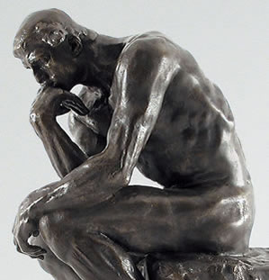
Do we need to prove God’s existence?
Year 9 Religious Studies
Autumn Term 1

Slide 2
Lesson 1: Facts, beliefs and opinions
Match the key word to the definition.
Fact | Something someone believes to be true but cannot quite prove it.
Opinion | Something we can prove to be true.
Belief | Someone’s personal view on a subject.
How would you categorise these statements? Fact, opinion or belief?
Manchester United is the best football team.
Boris Johnson is the UK’s Prime Minister.
The Earth is round.
The capital city of England is London.
When I die I will go to heaven.
Flowers are beautiful.
We cannot travel faster than light.
Prayer can make things happen.
God does not exist.
I might be dreaming right now.
How have you decided on these categories?
Proof? Evidence? Knowledge? Probability? Argument?

Slide 3
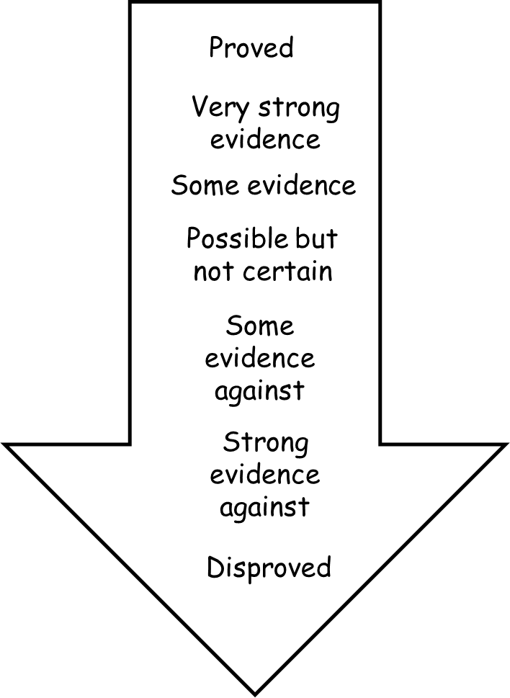
Apply the statements to your arrow.
The Earth is round
The sun revolves around the earth
The big bang began the universe
Scientists can explain everything without referring to God
God created the universe for a purpose
The world exists
Life has a meaning
Love is priceless

Slide 4
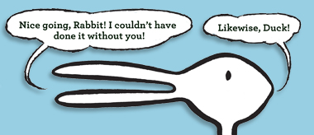
What is interpretation?
Interpretation in RE is where there are several possible meanings or answers to a question.
How does this apply to proof and evidence?
Proof and evidence are different things.
Proof is absolute and supports a theory becoming fact.
Evidence is more of a suggestion and can be open to interpretation.
When discussing beliefs about God it is more helpful to use the idea of evidence. Why do you think this is?
How can interpretation lead to different viewpoints about a belief in God?
Can something be true for one person and not for another? Give an example.

Slide 5
Who believes what about God?
There are several different positions that have different viewpoints on the existence of God – what do you think their positions are?
They need to use evidence to demonstrate their world view.
Write a definition of each word in your book and give an example of something they might use as evidence for their viewpoint.
Theists
Atheists
Agnostics.

Slide 6
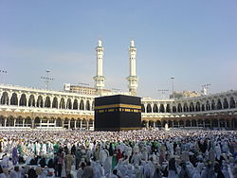
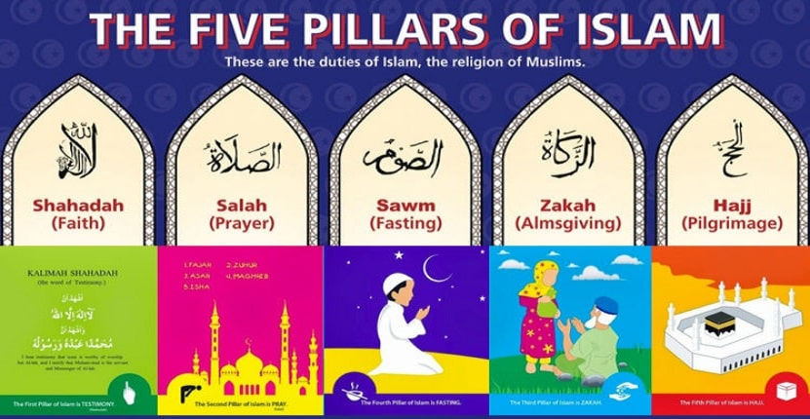
Lesson 2: Why do Muslims believe in God?
What do you already know about Muslims?

Slide 7
What is the Kalam argument?
Started with Aristotle and is also known as the Cosmological argument.
It is used by Jewish people, Christians and Muslims.
Some Muslims use this argument as one of the ways they can prove God exists.
The universe has a cause of its existence.
Therefore we must conclude that God exists
Create a flow chart showing the correct order of the statements in the Kalam argument.
Challenge: what are the strengths/weaknesses of this argument
The universe has a beginning of its existence
Therefore...
Everything that has a beginning of its existence has a cause of its existence.
If the universe has a cause of its existence then that cause is God, a being without beginning or end
Notes:
Could print to cut and stick if desired.

Slide 8
The Kalam argument
Everything that has a beginning of its existence has a cause of its existence.
The universe has a beginning of its existence
Therefore...
Therefore we must conclude that God exists
If the universe has a cause of its existence then that cause is God, a being without beginning or end
The universe has a cause of its existence.
‘The Kalam argument is so compelling that all Muslims are convinced that God is real because of it!’
What are the issues with the above statement??
Do you think that the Kalam argument is a strong or a weak argument for the existence of God? Explain your answer.
If the Kalam argument is NOT the reason that Muslims believe in Allah – what is?

Slide 9
Religious Experience
Religious experience is another argument Muslims use to try to demonstrate God exists. Although they may not use it as proof it helps them to sense God.
What do you think this could include?
How do you think these experiences will help Muslims to sense God?
Can personal faith be enough to prove God’s existence?

Slide 10
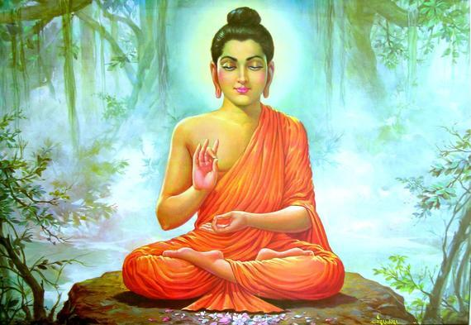
Lesson 3: Why did the Buddha think belief in God was unimportant?
What do you already know about Buddhism?

Slide 11
What do Buddhists think about God?
A Buddhist might believe in Gods, and might not. Either way these beliefs are not as important as doing what you can to reduce suffering. | The Buddha often sat silent when people asked him questions about gods and goddesses. Hew was more interested in the more important questions: How can we be happy? | Buddhism has grown in numbers in the West in recent years. Maybe this is because instead of claiming to know the truth about God, the religion has helped people to focus on the search fro calmness and peace.
What is the quote trying to say? Do you agree? Why? | What is the quote trying to say? Do you agree? Why? | What is the quote trying to say? Do you agree? Why?

Slide 12
Why does the Buddha not answer ‘God questions’?
The Parable of the poisoned arrow
A man went to the Buddha insisting on answers to his questions about God. The Buddha instead put a question to him: ‘If you were shot by a poisoned arrow and a doctor was summoned to extract it, what would you do?
Would you ask questions such as who shot the arrow, who made the arrow etc or would you have the doctor immediately pull out the arrow?’
The man replied ‘I would have the arrow pulled out as quickly as possible.’ The Buddha concluded, ‘That is wise, for the task before us is the solving of life’s problems; until the problems are solved, these questions are of secondary importance. ‘Life does not depend on the knowing of how we got here or what will happen when we are gone...the ultimate question is: how can suffering be reduced?
Answer the following questions.
What does the Buddha say is the most important question?
Why does he refuse to answer questions about God?
How will this impact the lives of Buddhists today?

Slide 13
Actions or beliefs?
The teachings of the Buddha make no mention of a God who judges human actions. Instead Buddhists hold that humans themselves create their own consequences through their actions, without need of a divine judge. The question of whether God exists or not is not a concern of Buddhist thinkers. More important are ways to alleviate suffering and live a balanced life.
What can Buddhists do to ensure that their actions bring peace?
Write a list of actions Buddhists can do to reduce suffering?

Slide 14
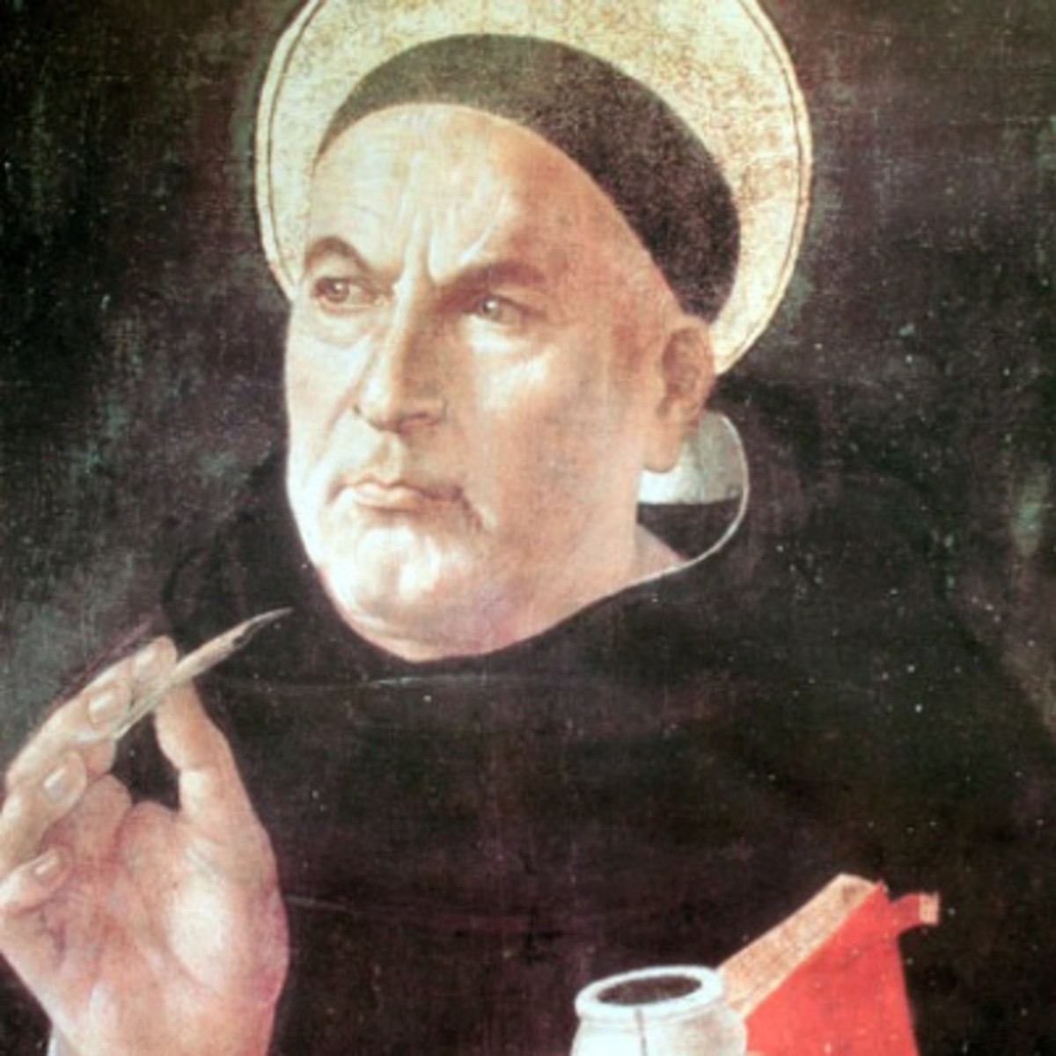
Lesson 4; Do Thomas Aquinas’ ‘5 Ways’ justify Christians’ belief in God?
St Thomas Aquinas is one of the most famous Christian philosophers; he has contributed lots of different ideas about how and why Christians believe God exists as well as how Christians should act when interacting with others in the world.
Aquinas was convinced that reason and logic did not have to operate separately to faith and that it was possible to logically prove the existence of God. His most famous ideas are known as the ‘Five ways.’
Read through the arguments you have been given.
Underline/highlight any words or phrases you don’t understand.
Rank the arguments in the following order:
Most persuasive argument for God’s existence
Least persuasive argument for God’s existence
Write a short PEE paragraph to explain your top and bottom arguments.
Challenge: How might an atheist counter the arguments you have been given?

Slide 15
Do Thomas Aquinas’ ‘5 Ways’ justify Christians’ belief in God?
First Way: God is the ‘unmoved mover’. Before the Universe began, nothing moved. Then the universe moved from being a potential universe to a real universe. The being that made this move is called God. God alone, who is eternal, does not need to be moved from a potential being to a real being.
Second way: God is the cause of all things. Like a run of dominoes, everything has a cause or a start. The first cause of the universe can be called God, who alone does not have a cause.
Third way: God is not only necessary to cause the universe but to sustain it. Things come into existence and then cease to exist (eg animals die) but new life is constantly born. The continuing existence of the universe must depend upon one thing that does not depend on anything else for its existence, and cannot itself die. This being is what people mean when they say ‘God. ‘
Fourth way: We can see there is goodness and truth in the world (but also hatred and dishonesty). All goodness and truth must stem from a source of pure goodness and truth which we call God.
Fifth way: Why does nature work so well? We can observe regular laws and patterns in nature. These complex and regular patterns and laws cannot be explained by the thing in nature themselves, so must rely on a design and therefore a designer. God is the designer.

Slide 16
Do Thomas Aquinas’ ‘5 Ways’ justify Christians’ belief in God?
Most persuasive argument for God’s existence
Least persuasive argument for God’s existence
Challenge: How might an atheist counter the arguments you have been given?
Bertrand Russell said that if he met God after death, his first question would be
‘why do you make your existence so obscure to the living?’
Write a letter from God as a reply to this question?

Slide 17
Lesson 5: The Design argument
Looking at the universe you can see intelligent design for purpose – human eye, birds wing, the solar system.
The designer of the universe must have ultimate power and so it must be God.
A design must have a designer
Looking at a watch you can see intelligent design for a purpose – to tell the time.
Read through the statements above and see if you can put them in the correct order.
1.
2.
3.
4.
Notes:
Alternative task – cut out and sequence into the correct order.

Slide 18
The Design argument
Looking at the universe you can see intelligent design for purpose – human eye, birds wing, the solar system.
The designer of the universe must have ultimate power and so it must be God.
A design must have a designer
Looking at a watch you can see intelligent design for a purpose – to tell the time.
Did you get it right?
1. Looking at a watch, you can see intelligent design for a purpose – to tell the time.
2. Looking at the universe you can see intelligent design for purpose – human eye, birds wing, the solar system.
3. A design must have a designer
4. The designer of the universe must have ultimate power and so it must be God.
Notes:
Alternative task – cut out and sequence into the correct order.

Slide 19
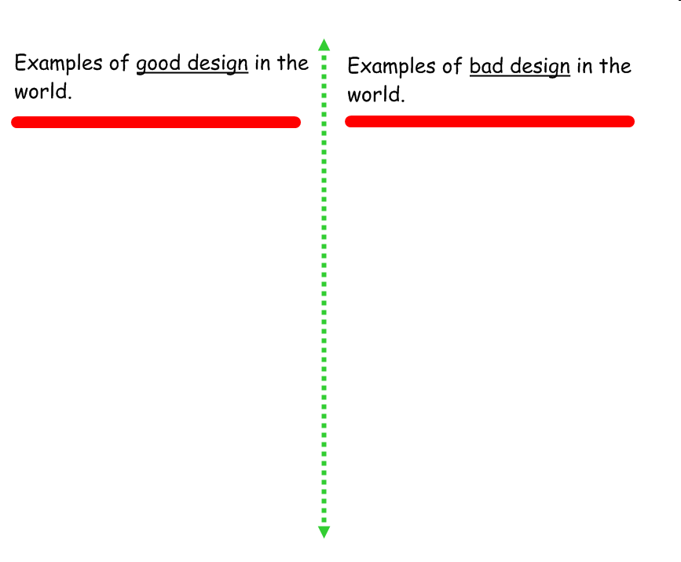
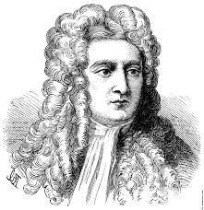
Where can we see design in the world?
Isaac Newton used the fact that we have opposable thumbs as evidence of design. Thumbs are called opposable because they can be moved around to grip things. This is a movement only found in humans and primates, and is regarded by theists as evidence of God’s design.
“In the absence of any other proof, the thumb alone would convince me of God’s existence.”
Challenge: how can the opposable thumb be used as evidence that God does not exist?

Slide 20
What do Christians think about design?
Isaiah 45:18
For this is what the Lord says— he who created the heavens, he is God; he who fashioned and made the earth, he founded it; he did not create it to be empty, but formed it to be inhabited— he says: “I am the Lord, and there is no other.
Does this Bible quote support or deny the teleological argument? How?
Paul the Apostle (AD 5-67), argues in Romans 1:18-20, that because it has been made plain to all from what has been created in the world, it is obvious that there is a God.
Does this Bible quote support or deny the teleological argument? How?

Slide 21
Does the teleological argument prove the existence of God?
Come up with 3 strengths and 3 weaknesses of the teleological argument.
Strengths:
1.
2.
3.
Weaknesses:
1.
2.
3.
Challenge: How can we argue against the strengths and weaknesses you have come up with?
Do any of your strengths and weaknesses counteract each other? How?

Slide 22
Lesson 6: What are the arguments against God’s existence?
Read through the arguments you have been given?
Put them in order of most convincing to least convincing.
Write a short PEE to explain why they are in the order they are.
I think that science has disproved religion. Evolution and physics tell us where we came from—not Adam and Eve.
Religious people claim to be for peace, but all they do is cause wars. Their claims to know the love of God are undermined by the practice of tribal hatred.
All the different religions on earth make contradictory claims. They cannot all be true so I reject them all.
I think the evil in the world is evidence that there cannot be a great God full of love.
If God made the universe, then who made God? It is unreasonable to imagine an eternal God.
Religion is out of date. In past ages people knew no better, but modern understanding of the universe has pushed religion to the edge and over the edge; we don’t need it anymore.
Religion often teaches that the afterlife will make right all that is wrong in this life, but there cannot be good evidence of survival beyond the grave.
There are many stories claiming that God does miracles. Mostly they collapse when investigated. But even if they were true, why would God only do a few miracles? Would a Good God not save the children who starve?

Slide 23
What are the arguments against God’s existence?
Most persuasive argument against God’s existence
Least persuasive argument against God’s existence
Challenge: How might a theist counter the arguments you have been given?

Slide 24
Lesson 7: Who are the humanists?
This is the logo of the BHA.
What do you think it is supposed to represent?
2. If you were to think of a name of it what would be and why?
3. It is actually called the ‘Happy Human’, what does this tell you about humanist philosophy?

Slide 25
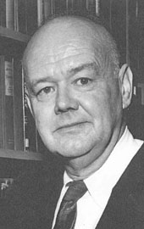
A Secular philosophy?
Humanism is a secular philosophy because it seeks to answer important questions about the world and the purpose of human life without any reference to God or the supernatural.
Humanism is a world view that only uses science, evidence, reason and empathy to make sense of the world and to inform how they should act and care for others.
The Humanist Manifesto was first written in 1933 by American Humanist Raymond Bragg. The first sentence said:
The time has come for widespread recognition of the radical changes in religious beliefs throughout the modern world. The time is past for mere revision of traditional attitudes.
What is a manifesto?
A manifesto is a public declaration of the policies or ideas of a group of people
Why do you think Bragg started with this statement

Slide 26
What does the manifesto say?
The Humanist Manifesto has been revised twice since 1933, most recently in 2003.
How do you think it will answer the following questions?
How do we know what is right and true?
What is the importance of human relationships in life?
Where do moral or ethical values come from?
How can we live happily?
How are human beings related to the natural world?
What does a fulfilled life look like?

Slide 27
Your manifesto?
Write your own manifesto which explains what you think and what you want in response to these questions:
How do we know what is right and true?
Where do moral and ethical values come from
What is the importance of human relationships.
How are human beings related to the natural world?
What does a fulfilled life look like?
How can we live happily?

Slide 28
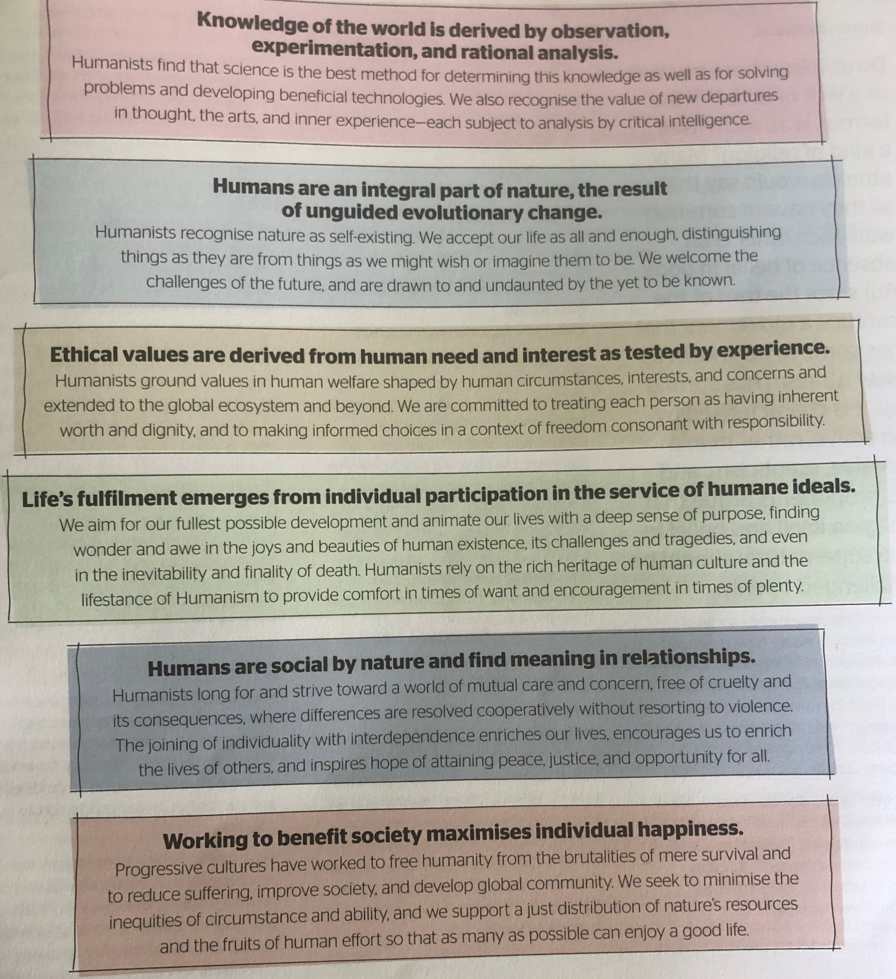
Does it match?
Read through the Humanist Manifesto.
Does it match your ideas?
Underline where it matches what you said.
Highlight where it is different.
Notes:
Class reading activity. Print manifesto from Examining religion and Belief: Atheists book pg 9

Slide 29
Lesson 8: How important is the idea of proving or disproving God?
You have 3 different pictures – each one is a response from a school pupil aged 11-14 to the question ‘Who/where is God?’
Make notes on the similarities and differences between each picture and decide on the odd one out.
Why do you think they have responded to the question in these different ways?

Slide 30
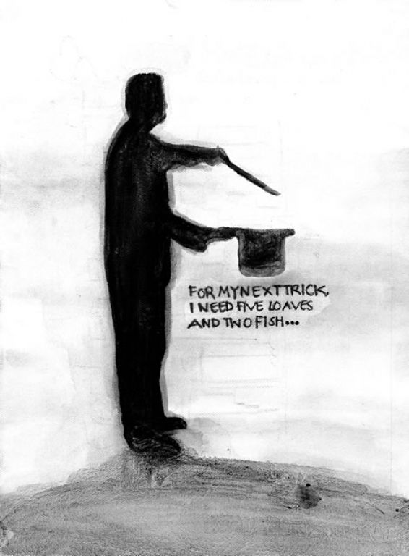
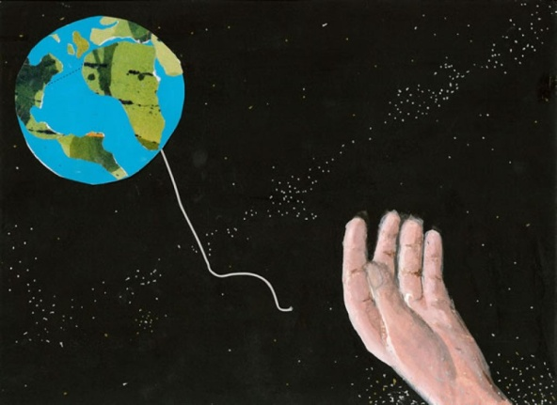
I can see...
Similarities between 1 and 2
I can see...
Differences between 1 and 2
2
1
The odd one out is....
This is because...
Similarities between 1 and 3
Similarities between 2 and 3
3
Differences between 1 and 3
Differences between 2 and 3
I can see...

Slide 31
Why do people say God does or does not exist?
Why do people say God does or does not exist? Come up with 6 reasons on each side. You are going to divide your pie chart up to show how much you think each idea is responsible for the different beliefs.
God IS real.
1.
2.
3.
4.
5.
6.
God IS NOT real.
1.
2.
3.
4.
5.
6.

