Slide 1
Year 10 History Workbook
The Development of the USA
1929-2000
The Great Depression

Slide 2
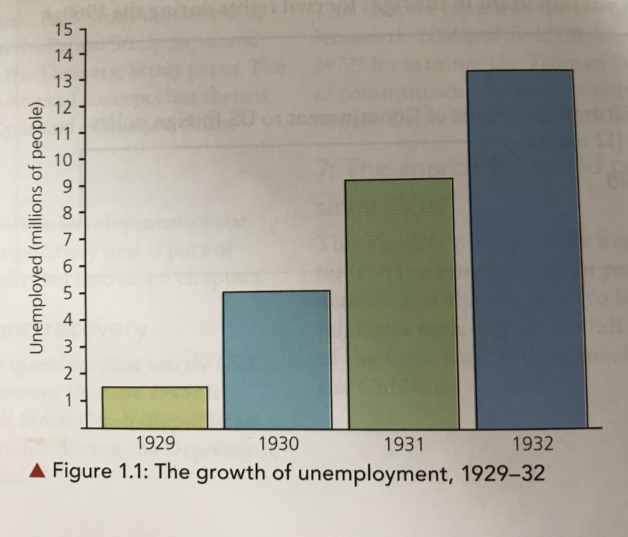
Lesson 1: The Wall Street Crash
The Wall Street Crash
During the 1920s, there was an economic boom and share prices were high. But in 1929 share prices began to fall and experts began to sell their shares.
This led to panic selling from small investors.
On Black Thursday, 24th October 1929, 13 million shares were sold and share prices collapsed.
Thousands of investors lost millions of dollars and were ruined.
This became known as the Wall Street Crash.
The Impact
The Wall Street Crash led to the Great Depression.
There were four consequences:
Unemployment
Depression in the cities
Depression in the countryside
Family life
Task
As you go through the information below and on the next page, make a mind map of the four consequences of the Great Depression.
Consequence 1: Unemployment
The collapse of the economy led to many businesses closing.
Before the crash, unemployment was at 1.5 million.
By 1932, 13 million people were unemployed.

Slide 3
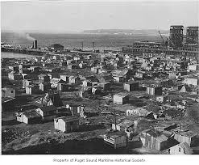
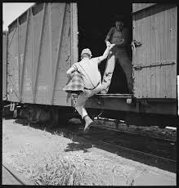
Consequence 2: Depression in the Cities
As people stopped spending, production had to slow down or stop. This increased unemployment in cities.
As people lost their jobs, they lost their homes. Many built alternative ‘homes’ in areas which became known as Hoovervilles. These were shanty towns build on the edge of cities.
Many of the unemployed in cities slept on the streets. Some moved across the country as hobos (someone who is unemployed and wanders around between cities). They caught rides on freight trains in search of work. By 1932 there were 2 million hobos.
Black workers were often the first to be sacked. Black unemployment was 50% by 1933. It was 20% for white Americans.
Consequence 3: Depression in the Countryside
Farmers went bankrupt because they could no longer sell their produce.
In 1931, a drought made prices fall even more.
Oklahoma, Colorado and New Mexico were the worst hit by the drought. Poor farming methods had exhausted the soil and in the drought the soil turned to dust. When the winds came, it blew the soil away. The area became known as the ‘dust bowl’.
More than a million people moved to the west coast. They set up camps on the edge of towns and got work wherever they could.
The locals often resented them for taking their jobs.
Consequence 4: Family Life
The number of marriages fell. The birth rate also fell.
The suicide rate rose dramatically.
In some states, schools were closed down for ten months of the year because there was no money to pay the teachers.
By 1932, about 25% of the population was receiving no income. There was no social security system so the unemployed relied on charities to support them.

Slide 4
The Bonus Marchers
The Bonus Marchers were WW1 veterans who had been promised a bonus for serving in the war. It was due to be paid in 1945, but the veterans didn’t want to wait that long to be paid.
In 1932, 12,000 unemployed and homeless veterans marched to Washington to support a bill which would allow for early payment of the bonus.
They took their wives and children with them and built a Hooverville on the edge of Washington.
It would have cost $2.3 million to pay the bonuses and Hoover felt this was too much. Money was provided to pay for transport home for the marchers, but 5000 refused to go. The police were sent in to clear the Hooverville.
Conflict broke out and the army was called in to control the situation. More than 100 people were injured.
Many people saw this as further proof that Hoover didn’t care.
Task
Who were the Bonus Marchers?
Why did Hoover refuse to pay the bonus?
What happened to the 5000 people who refused to leave the Hooverville?

Slide 5
Lesson 2: The Republican Response to the Great Depression
What did Hoover believe?
The President at the time of the Great Depression was a Republican called Herbert Hoover.
He believed:
Task
Summarise each belief into one sentence.
What did Hoover do?
Hoover followed the Republican ideas of laissez-faire and rugged individualism. He wanted to balance the budget and refused to borrow money.
But he did do something:
Hawley-Smoot Tariff Act – protected farmers by imposing import duties on foreign goods. Other countries refused to trade with the USA in response.
Agricultural Marketing Act – allowed the government to lend money to farmers through groups which tried to fix price levels.
Relief agencies – promoted local relief efforts.
Cut taxes.
Got approval for $1.8 billion for new construction and repairs to roads and dams.
Laissez-faire – the belief that people should help themselves
Rugged individualism – the belief that individuals are responsible for themselves and should not expect help from the government
Task
How did Hoover try to help farmers?
Do you think these measures will make much difference?

Slide 6
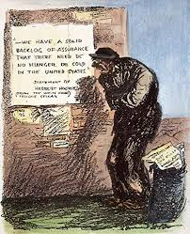
Hoover’s Policies in 1932
As unemployment continued to rise, Hoover had to accept that his policies weren’t working. He introduced some new measures:
Task
What was the purpose of each measure?
How Successful was Hoover?
Hoover’s measures failed to end the Depression. Unemployment continued to rise.
Many Americans saw him as uncaring. A popular slogan was ‘In Hoover we trusted, now we are busted’.
But he wasn’t a total failure:
He had persuaded state governments to expand their public works programmes.
He began policies which were later followed by his successor, eg, helping banks and home owners.
Federal spending on public works was higher than the previous 30 years.
Task
How successful was Hoover in dealing with the problems caused by the Depression in the years 1929-32?
Source A: A cartoon showing an unemployed man looking at Hoover’s optimistic assessment of the state of the country, 1932
The statement says ‘We have a solid backlog of assurance that there need be no hunger or cold in the United States.
Task
What is the message in Source A?

Slide 7
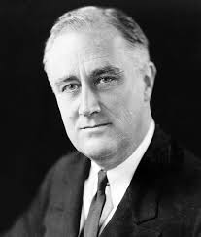
Lesson 3: The First New Deal
The 1932 Election
Roosevelt beat Hoover by a landslide – only 6 of the 48 states voted for Hoover.
This was partly due to Hoover’s unpopularity.
It was also because Roosevelt promised a New Deal which would create jobs and help agriculture and industry.
The Aims of the New Deal
The aims were based on the ‘three Rs’:
The Hundred Days
Roosevelt introduced a huge number of programmes in his first hundred days as President.
The first task was to stem the crisis in banking.
Roosevelt closed all banks for ten days. He then explained his plans on the radio to 60 million people.
He would allow banks with assets to re-open and those without assets would remain closed until they had a rescue programme. He assured people their money was safer in banks than at home.
This radio talk became the first of many fireside chats and gave people confidence in the banks.
Fireside chats – radio talks by Roosevelt to keep up the morale of the people
Task
Summarise the Hundred Days.

Slide 8
The Alphabet Agencies
The Alphabet Agencies is the nickname given to the government programmes that Roosevelt introduced.
They were based on the three R’s.
Task
In the fourth column of the table, write which of the three R’s the agency was designed to help.
Agency | Problem | Action | Three R’s
Emergency Banking Act (EBA) | Little confidence in banks, many banks bankrupt | All banks closed for 10 days. Roosevelt assured the public their money was safe. The government officially backed 5000 banks.
Federal Emergency Relief Administration (FERA) | Poverty and unemployment | Provided $500 million for emergency relief to help the poor and homeless, eg, providing food and clothing.
Civilian Conservation Corps (CCC) | Unemployment among young people | Provided six months of work for men aged 18 to 25 in conservation projects such as planting trees to stop soil erosion.
Public Works Administration (PWA) | Unemployment | Government spent $3300 million on public works projects for the unemployed – slum clearance, building schools, roads, hospitals.
Agricultural Adjustment Administration (AAA) | Rural poverty, low crop prices | Intended to help farmers increase their profits. Subsidies were paid to farmers to destroy their crops and slaughter animals to push up prices.
National industrial Recovery Act (NIRA) | Poor economic condition of the USA | National Recovery Administration (NRA) was set up to encourage employers to improve conditions. It introduced codes of practice for minimum wages, hours and conditions.
Tennessee Valley Authority (TVA) | Agricultural over-production, regular flooding in the Tennessee Valley | Huge public works programme set up to build 21 dams to irrigate the land and generate hydroelectric power. Farmers were given loans and training in soil conservation.

Slide 9
Exam Practice
Describe the First New Deal. (5 marks)
How to answer this question
Make sure you only include information that is relevant.
Use the words in the question to start your answer. (The First New Deal was…)
Try to include specific factual detail such as dates, events and names.
Aim for two or three features.
Writing Frame
You can use this to help you answer the question:
The First New Deal was….
It was based on the three R’s of relief, recovery and reform. For example, ….
Another example is….
The First New Deal was therefore important because….

Slide 10
Lesson 4: The Second New Deal
By the end of 1934, there were still 10 million unemployed. In January 1935, Roosevelt introduced his Second New Deal to help farmers, workers, the poor and the unemployed.
Task
As you go through the information below, make a mind map about the Second New Deal.
The Works Progress Administration (WPA)
This funded building projects to create employment.
It organised a $4.8 billion relief programme, put unemployed teachers back to work and created community service schemes to employ writers, artists and actors.
The National Labour Relations Act (The Wagner Act)
This Act allowed workers to organise and enter into collective bargaining.
The number of union members increased to 9 million by 1939.
It also set up the National Relations Board, which was given power to act against employers who used unfair practices, such as sacking workers who joined a union.
Fair Labour Standards Act
Minimum wages and maximum hours were set in commerce.
This gave 300,000 workers higher wages and more than a million had a shorter working week.
Child labour was only allowed on farms.
Social Security Act
This established pensions for the elderly, the orphaned and those injured in industrial accidents.
Unemployment benefits were funded by a tax on employers.
This is a very significant act because it represented the government finally acknowledging that they had a responsibility for meeting the basic needs of its citizens.

Slide 11
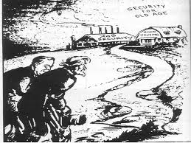
Source A: A cartoon from 1935: ‘Roosevelt the friend of the poor’
Task
What does Source A show you about the Second New Deal?
How Successful was the New Deal?
Task
Highlight or code each statement below to show whether it was a success or a failure.
Role of government and the president
The New Deal restored the faith of the people in government after the laissez-faire approach of Hoover.
It preserved democracy and ensured there was no mass support of right-wing politicians.
It greatly extended the role of central government and the president.
Roosevelt gave too much power to the federal government – it was too directly involved in areas traditionally managed by states.
Economy
The banking system was stabilised and fewer businesses failed.
It provided only short term solutions and did not solve underlying economic problems.
It improved the infrastructure of the USA by providing roads, schools and power stations.
The US economy took longer to recover than most European countries.
Unemployed and industrial workers
The Alphabet Agencies provided only short term jobs. Even at its best, there were still over 14 million unemployed.
Unemployment fell from 24.9 million in 1933 to 14.3 million in 1937.
The position of unions was strengthened.
Unions were still treated with suspicion by employers and make strikes were broken up with brutal violence.
Social welfare
The USA now had a semi-welfare state which included pensions for the elderly and help for the sick and disabled.
Some argued the social welfare measures put too much pressure on tax payers and encouraged people to ‘sponge’ off the state.
Black Americans
Many New Deal agencies discriminated against black people. They were given no work or received worse treatment and lower pay.
Around 200,000 black Americans received benefits from the CCC and other agencies. Many benefitted from housing projects.
Roosevelt did little to end segregation and discrimination.
Women
Some state governments tried to avoid social security payments to women.
Some women were promoted. Eleanor Roosevelt became an important campaigner for social reform.
Some of the National Industrial Recovery Act codes actually required women to be paid less than men.
Only 8000 women were employed by the CCC out of the 2.75 million involved in it.

Slide 12
Task
How successful was the New Deal?
Look at both sides of the argument before reaching a decision.
How was the New Deal successful?
What were the limitations or failures?
Conclusion – what is your overall opinion?
Sentence Starters
The New Deal was successful because….
However, there were limitations….
Overall, I think the New Deal was successful/unsuccessful because….

Slide 13
Lesson 5: Opposition to the New Deal
Who Opposed the New Deal?
A key point to remember is that Roosevelt was a Democrat, so the Republicans were always going to oppose him. They still believed in rugged individualism so they thought the New Deal went too far in helping people.
Some key individuals argued the opposite – the New Deal did not go far enough.
And then there was the Supreme Court. As the judges were mainly Republican, they did not support Roosevelt.
Supreme Court – the highest court in the USA. It made sure everyone, including the President, followed the Constitution.
Task
There is a worksheet on the next page. Use the information that follows the worksheet to fill it in.

Slide 15
Individuals
Several people argued that the New Deal did not do enough.
Huey Long
Huey Long had been the Governor of Louisiana. He said that Roosevelt hadn’t shared the wealth of the USA out fairly. He planned a campaign called Share Our Wealth. He had a lot of support, but he was killed by a doctor whose career he had ruined.
Charles Coughlin
Charles Coughlin was a Catholic priest. He called Roosevelt the ‘anti-God’ because he hadn’t done enough to help the poor. He was influential because he broadcast weekly radio shows to over 40 million listeners.
Frances Townsend
Frances Townsend was a former doctor and old-age activist. He had a lot of support from the elderly who gained little from the New Deal. He set up Townend clubs which had five million members by 1935.
Opposition from Politicians
The Republicans were strong opponents. They represented the interests of America’s richest families and large businesses. These people believed Roosevelt was doing too much to help poor people and was changing the accepted role of the government.
The America Liberty League was set up in 1934 to preserve individual freedom. It was backed by wealthy businessmen. It believed that the New Deal threatened the constitution of the USA and the freedom of the individual.
Conservative Democrats opposed the New Deal. Many of them were from the South and represented farming areas. They particularly opposed the Wagner Act which had given greater powers to the trade unions.
The Supreme Court
The Supreme Court was dominated by Republican judges.
Out of 16 cases concerning the Alphabet Agencies, the judges declared that in 11 of the cases Roosevelt had acted unconstitutionally. In reality, he was using central or federal powers which the Constitution had not given him.
The Sick Chickens Case
The Schechter brothers ran a poultry business. In 1933 the signed the rules of the National Recovery Administration (NRA) which had been set up by the National Industrial Recovery Act (NIRA). The rules governed fair prices, wages and competition. In 1935, NIRA took the Schechters to court for selling a batch of diseased chickens. The Schechters appealed to the Supreme Court which declared NIRA illegal because its activities were unconstitutional. It gave the federal government powers that it should not have to interfere in state affairs. As a result, 750 NRA codes of practice were immediately scrapped.
US v Butler
In this case the Supreme Court declared the Agricultural Adjustment Act (AAA) illegal. The judges decided that giving help to farmers was a matter for each state government, not the federal government. It resulted in all help to farmers ending.

Slide 16
Exam Practice
Explain why many Republicans opposed the New Deal. (8 marks)
How to Answer
‘Explain why’ means give a reason for something.
You need to provide a range of reasons.
Each reason needs to be supported by factual detail.
Aim to have two or three reasons and use PEA to help you keep the answer relevant.
What could the reasons be:
1) Traditional opponents of the Democrats
2) Dominated the Supreme Court
3) Had the support of wealthy businesses
This is an example of the first paragraph:
Many Republicans opposed the New Deal because they disagreed with the Democratic ideas that the state should help individuals. Republicans believed in laissez-faire and rugged individualism. This means that people should be responsible for their own lives and not rely on support from the government. They argued that the New Deal went too far in interfering in the lives of people. It was the first time the federal government had offered this level of support and the Republicans believed it was a dangerous precedent to set. Therefore, many Republicans opposed the New Deal because it went against their political beliefs.

