Slide 1
YEAR 10
CORE RE
WORK BOOKLET 1
Religion and British Society

Slide 2
Lesson 1: What role does Religion play in British Society?
Starter Questions to think about …
Do you think Britain is categorized as a Religious country?
What are the main religions in the UK in your opinion?
Does religion matter in your opinion?
Write your thoughts here ….
TASK According to the 2011 Census how many people do you think said they followed these religions in England? Guess the percentage
Christianity
Islam
Hinduism
Sikhism
Judaism
Buddhism
Other religion

Slide 3
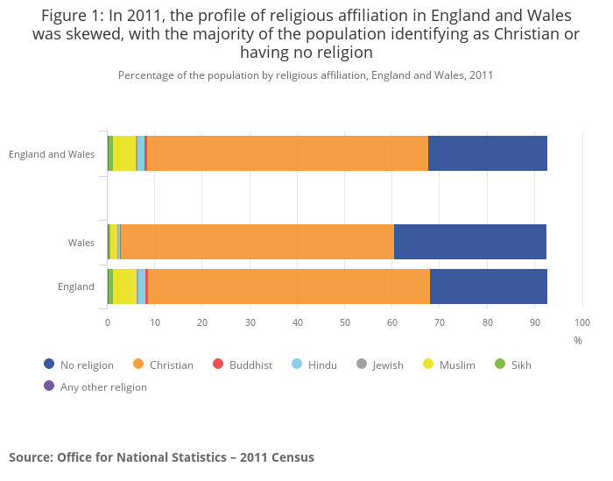
The Answers!
Religion | No religion | Christian | Buddhist | Hindu | Jewish | Muslim | Sikh | Any other religion
England | 24.7 | 59.4 | 0.5 | 1.5 | 0.5 | 5.0 | 0.8 | 0.4

Slide 4
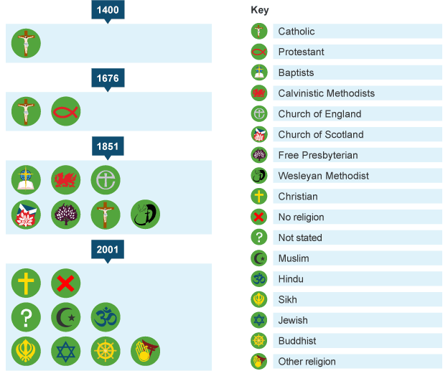
Religion in the UK Over Time has changed. Look at this diagram
Questions
Using the diagram
What religion was the first religion in the UK?
How many were registered in the UK in 2001?
Why do you think the number has changed over the years?

Slide 5
Lesson 2 Why are some people in Britain rich and some people do not have enough money?
Starter questions:
What is the largest religion in the UK?
How has british society changed in the last 100 years?
Do you think that wealth is evenly distributed in the UK.
How does this make you feel?

Slide 6
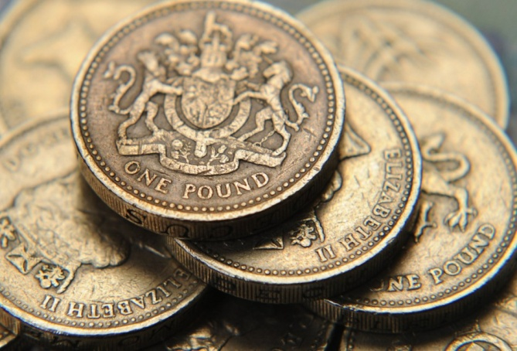
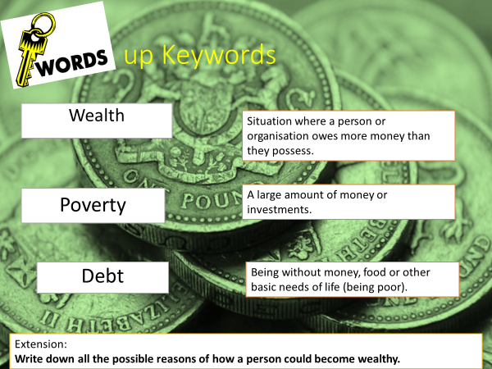
Have all the money in the world OR be happy but live a comfortable lifestyle ....
Depending on what you have chosen answer the following questions:
What would day to day spending be like?
Do you think you would change as a person i.e. Personality?
Would you judge others around you?
Would you be happy with the money you have?
Task: Match up the key words

Slide 8
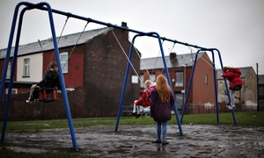
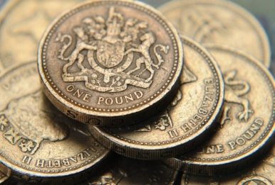
Read the Article: Britain faces future divided by rich and poor, poverty commission warns.
Britain is on the brink of becoming a nation permanently divided between rich and poor. It also predicts that 2010-2020 will be the first decade since records began that saw a rise in absolute poverty – defined as a household in which income is below 60% of median earnings. A rise from 2.6 million households in absolute poverty to 3.5 million is now expected.
The report warns that “2020 could mark a watershed between an era in which for decades there have been rising living standards shared by all and a future era where rising living standards bypass the poorest in society.”
It suggests that the link between effort and reward, on which social mobility relies, has been broken by changes in the housing market – with home ownership rates halving among young people in 20 years – and the labour market – with 5 million workers trapped in low pay earning less than the living wage and jobs are insecure.
The commission made some major recommendations:
• The UK should commit to implementing a living wage by 2025 at the latest.
• The Office of Budget Responsibility should publish an assessment of each Budget for its impact on social mobility and child poverty.

Slide 9
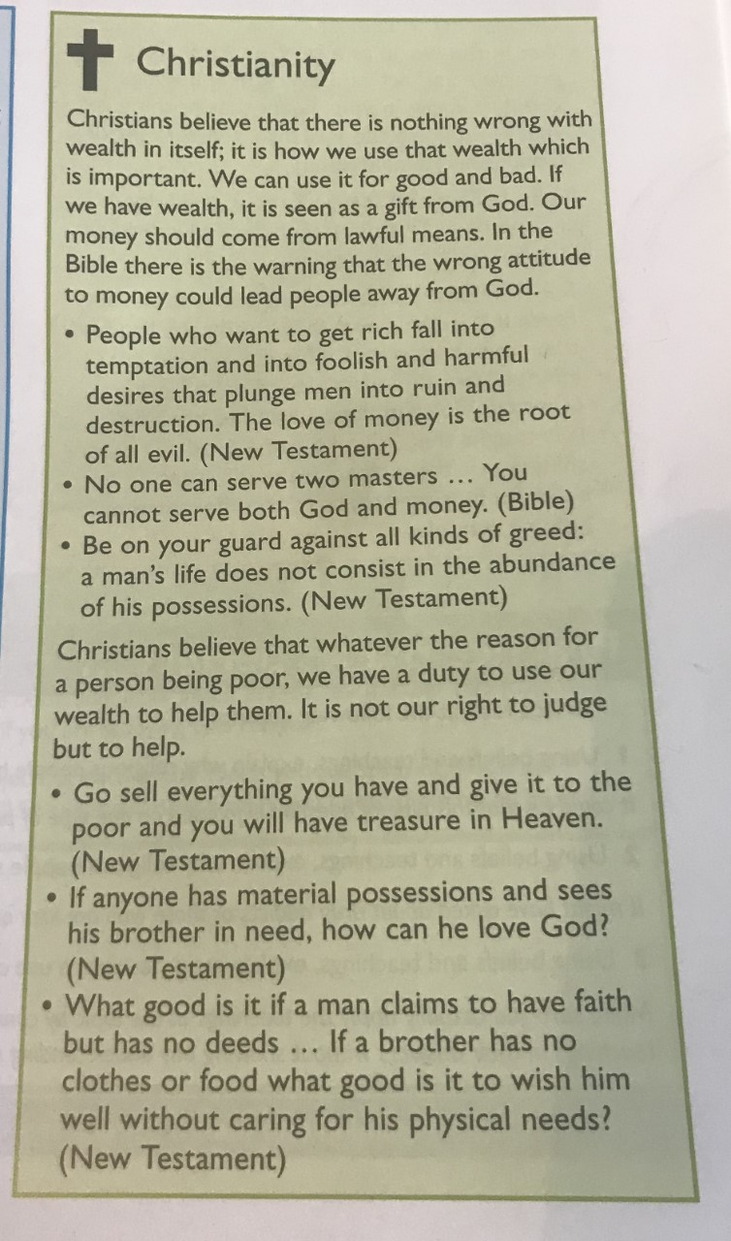
Questions from article
Write down one shocking statistic you have read from this article.
Why do you think this divide even exists?
Do you think this divide will always be present no matter how much is tried to eradicate it? Why?
Extension:
What solutions do you pose to eradicate the division between the rich and the poor? How and why would they work?
Task: read the Christian beliefs about wealth and create a spider diagram summarising them.

Slide 10
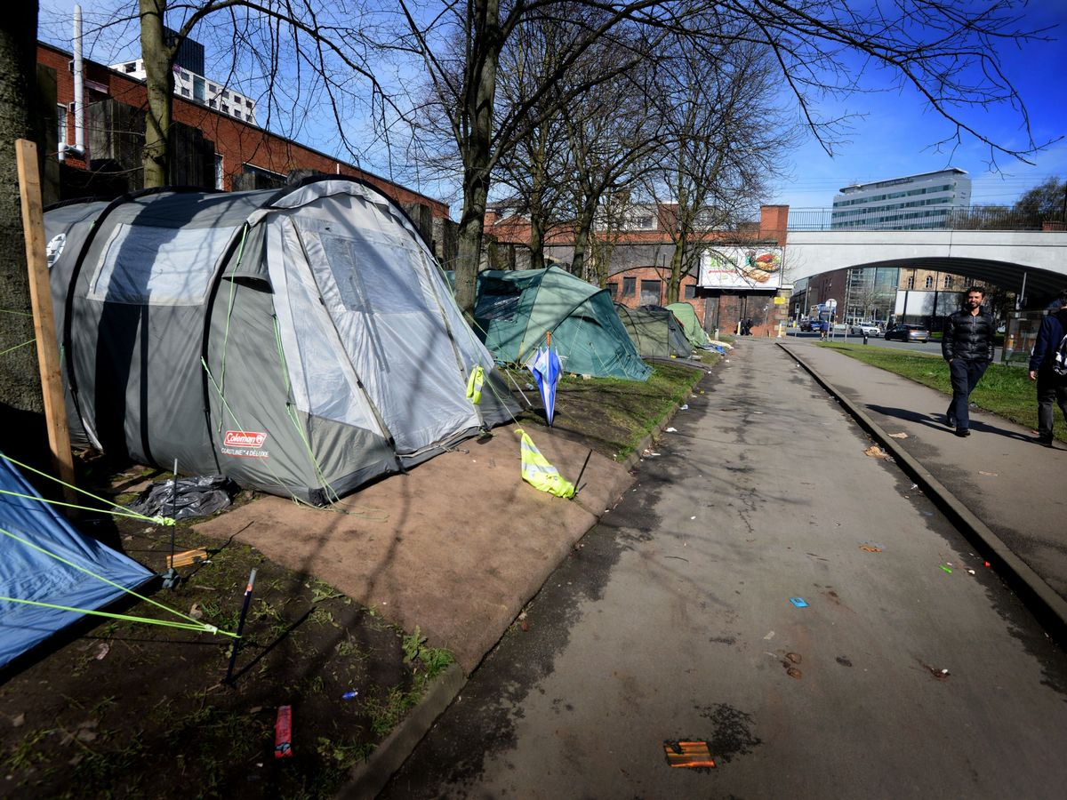
Lesson 3: The problem of homelessness and what can we do to help?
Starter Questions:
How is wealth spread out in the UK?
What do Christians think about wealth?
What problems are caused by poverty?
Look at the image:
Have you seen this in person?
How does it make you feel?
How would it be to live in a place like this?

Slide 11
280,000 people in England are homeless, with thousands more at risk
New figures from Shelter reveal 280,000 people are recorded as homeless in England, an increase of 23,000 since 2016 when the charity first published its landmark annual report.
Shelter’s extensive analysis of official rough sleeping and temporary accommodation figures, along with social services records, shows that in one in every 200 people are without a home. For the first time, its review of government data has also exposed that close to 220,000 people in England were threatened with homelessness in the last year.
Despite being the most comprehensive overview of homelessness in the country, it’s widely known that a lot of homelessness goes undocumented, including sofa-surfing and some rough sleeping. This means the true level of homelessness will be even higher than today’s count. Shelter is warning that unless the new government takes urgent action to address the dire lack of social homes at the crux of this emergency, the situation is likely to get worse.
TASK Read the article above: highlight the statistics (facts) on homelessness.
Underline the problems caused by homelessness.

Slide 12
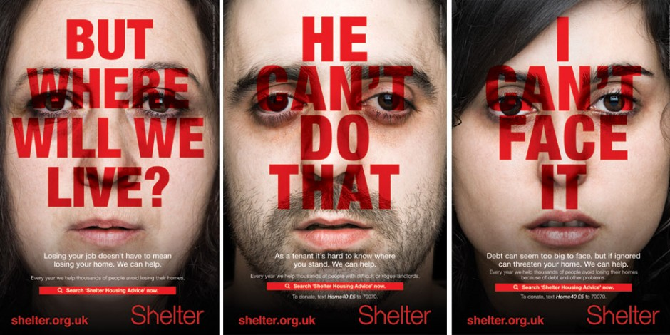
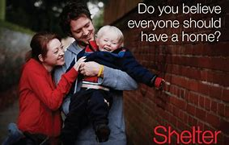
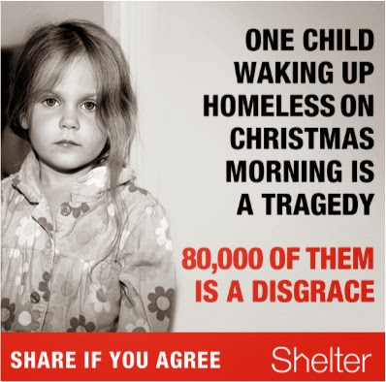
Shelter is a British charity that tries to help homeless people find homes. Using the images above create a poster to advertise their work.
You can use the previous article to help you.

Slide 13
Lesson 4 What is the problem with gambling? How can religions help?
Starter questions:
How big is the problem of homelessness in the UK?
What is the rich and poor divide in the UK?
How many people say they are religious in England?

Slide 14
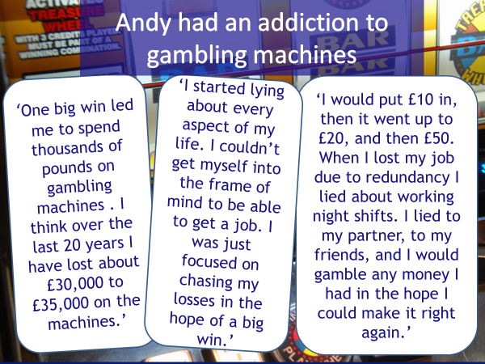
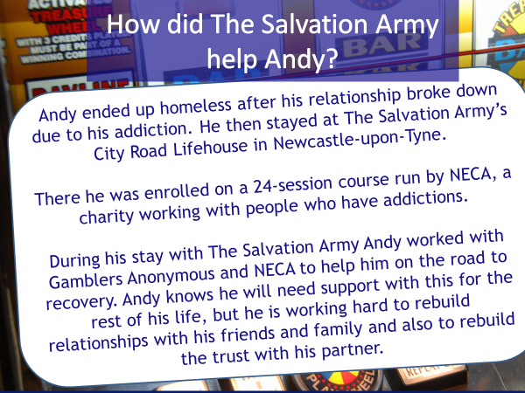
Task: Create a diary entry for a day in the life of Andy when he was addicted to gambling machines.
Then create a diary entry for day where he was receiving help for his addiction.

Slide 15
‘Christians should never gamble’ Do you agree with this statement? Why?
Task:
Using the quotations above create a spider diagram about the Christian teachings on gambling.

Slide 16
Lesson 5: What issues does Drug Abuse cause? What do religions believe?
Starter questions:
Describe the problem of homelessness in the UK
What is gambling?
What is the rich/poor divide?
What is the major religious tradition in Britain?
Individual task:
Write down a list of all the drugs that you know of, whether they be legal or illegal, strong or weak, known or unknown, common or not common.
Think carefully about your everyday life and where you use drugs.

Slide 17
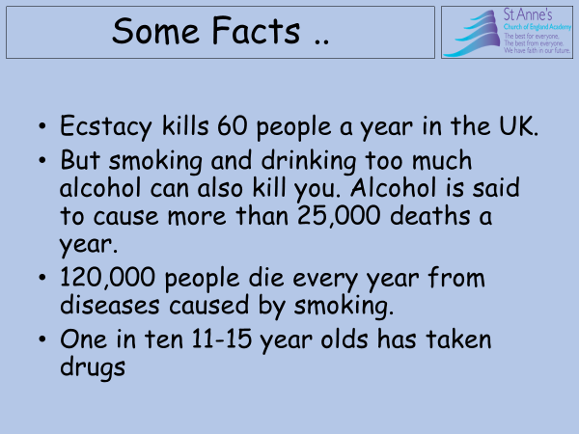
Illegal Drugs are categorised into the categories below according to the law.
Drug classification and penalties
Classes | Drugs | Penalties for dealing in drugs | Penalties for possession of drugs
Class A | Ecstasy, LSD, heroin, cocaine, crack, magic mushrooms, amphetamines (if prepared for injection) | Up to life in prison or an unlimited fine or both | Up to seven years in prison or an unlimited fine or both
Class B | Amphetamines, methylphenidate (Ritalin), pholcodine, cannabis, ketamine | Up to 14 years in prison or an unlimited fine or both | Up to five years in prison or an unlimited fine or both
Class C | Tranquilisers, some painkillers, gamma hydroxybutyrate (GHB) | Up to 14 years in prison, an unlimited fine or both | Up to two years in prison or an unlimited fine or both

Slide 18
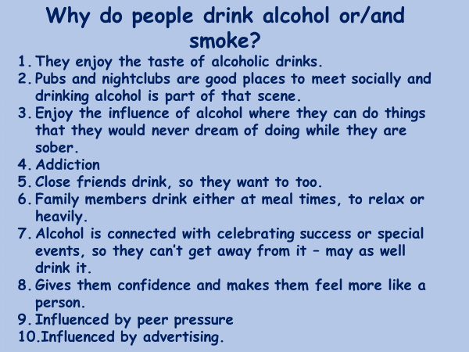

Slide 19
Christian attitudes towards drugs
The key Christian teaching in relation to the use of drugs is that the physical body is the natural home of the soul, and is therefore precious and sacred.
“ Your body is a temple of the Holy Spirit.” 1 Corinthians 6:19
So Christians do not approve of the taking of illegal drugs, including most recreational drugs, especially those which can alter the mind and make people incapable of praying or being alert to God.
Christians will take prescription drugs when appropriate.
Alcohol, tobacco and caffeine are examples of recreational drugs which are not forbidden to Christians.
Task:
Read the information above
Highlight the key Christian beliefs
Answer the question:
Explain Christian attitudes to drug abuse (2 Marks)

Slide 20
Create a poster explaining both the Christian and Muslim attitudes to Drugs.

Slide 21
Lesson 6: What can charities do to help in the UK?
Starter questions:
What are some issues affecting British society?
What issues can drug abuse cause?
What is gambling?

Slide 22
Task: Complete the following 2 worksheets.

Slide 24
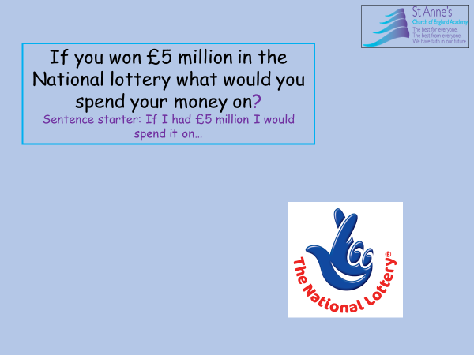
Lesson 7: The National Lottery. Does it help?
Starter questions:
What is gambling?
What do religions say about gambling?
What is the rich/poor divide in the UK?

Slide 25
Task Answer the questions above – you can use the space below to answer.

Slide 26
The National Lottery Information:
Read the information provided and highlight key facts.
On 19th November 1994 the National lottery was born, there were 7 jackpot winners who each won £840,000 each. The National lottery is a weekly gambling competition that is available to all over 16’s and offers large prizes. It also gives money to charity.
Some critics argue that the National lottery is nothing more than an extra voluntary tax paid by the poor in the vain hope of winning enough to take them out of the poverty trap. After all, the rich have no need to buy a ticket because, although winning would be nice it would not have such a dramatic effect on their lives.
There are some critics who argue that there is a risk that ‘unsuitable’ people may win. There have been instances where criminals or people who have antisocial behaviour have ended up with millions of pounds which people feel they don’t deserve or can’t cope with.

Slide 27
There are 4 categories that count as a ‘good cause’:
Arts
Heritage
Sport
Environment (including health and education)
Some people argue that money doesn’t always go to the people who need it the most. For example the National Lottery gave money to the Royal Opera House and British museum, critics argued this money doesn’t benefit the poor.
Islamic teachings forbid any form of gambling, this includes the National Lottery, as it is seen as a way of earning money that does not involve doing honest work, and it can promote greed and encourage laziness. They believe money should be used for the necessities of life.
For every person who becomes richer as a result of gambling, many others become poorer. Islam will not bid for lottery funding for projects neither will they accept any money that has come as a result of playing in the National lottery.

Slide 28
Some Christian denominations e.g. Methodists share the Islamic view on gambling, however other denominations (Church of England, Roman Catholics) whilst they do not actively encourage gambling, will allow believers to gamble in moderation.
Some Christian Charities use the National Lottery ‘good cause’ funds. They may use them to support particular projects such as feeding the homeless, supporting young people and other forms of life education. The Heritage fund has also provided finance to help rebuild and fix churches and cathedrals.
Islamic teaching from the Qur’an explicitly says, ‘wine and games of chance are abominations devised by Satan. Avoid them, so that you may prosper’. Christian teaching from the Bible says, ‘Do not wear yourself out to get rich, have wisdom to show restraint’.
Task: Create a summary of the information about the national lottery you have read.

Slide 29
Example of a Good Summary:
Some argue that the National lottery is like an extra voluntary tax paid by the rich/poor/middle class in the hope that winning will take them out of the poverty cycle/mindset/trap. Some argue that the National lottery runs the risk of an ‘unsuitable’ person winning, for example, convicted criminals or people with antisocial/rebellious/disruptive behaviour have ended up with millions of pounds they cannot cope with. Muslim teaching allows/forbids/permits any form of gambling, this includes the National lottery. They see it as a way of earning money through dishonest means this can promote greed and laziness. In Islam they do/do not/sometimes accept lottery funding for projects. In the Qur’an it says ‘wine and games of chance are sins/foolishness/abominations devised by Satan’ This quote is saying that gambling is sinful and therefore must be avoided However one big selling point of the National lottery is that for every £1 raised, 25p/26p/28p goes to ‘good causes’.. On the other hand some Christian denominations such as the Methodists/Baptists/Church of England, whilst they do not encourage gambling, they will allow believers to gamble in moderation. In the Bible it says ‘have wisdom to show control/restraint/command’.

