Slide 1
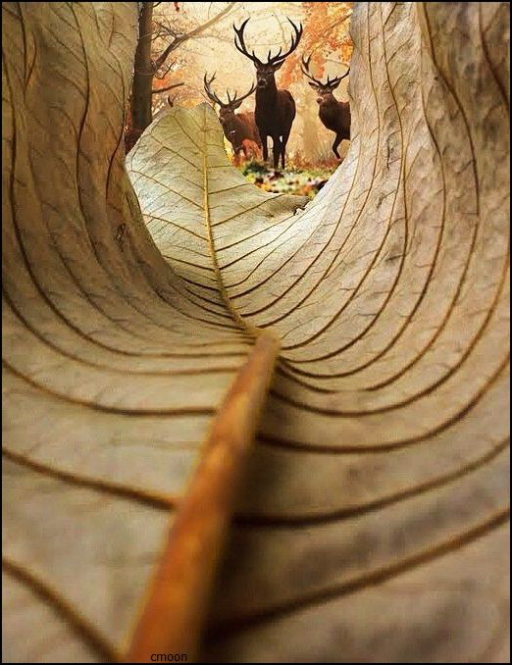
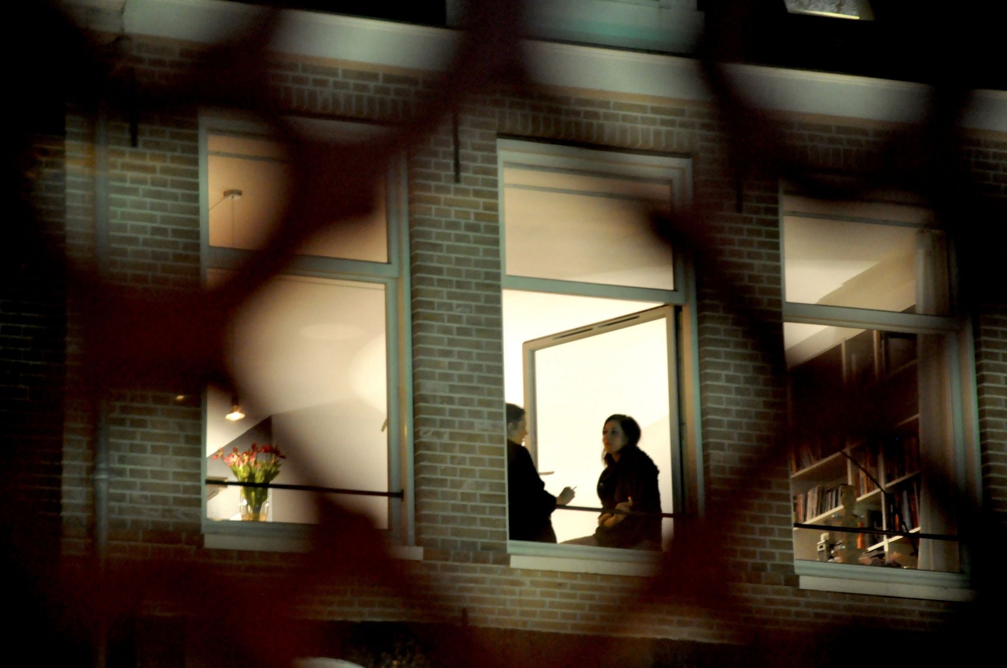
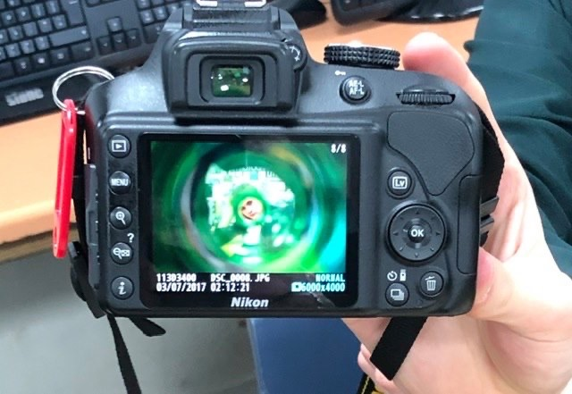
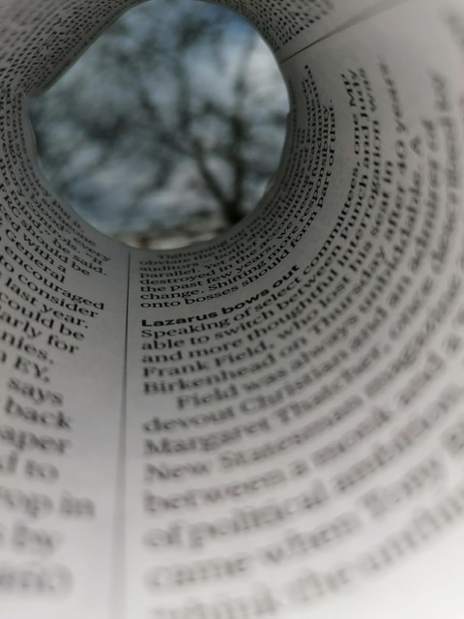
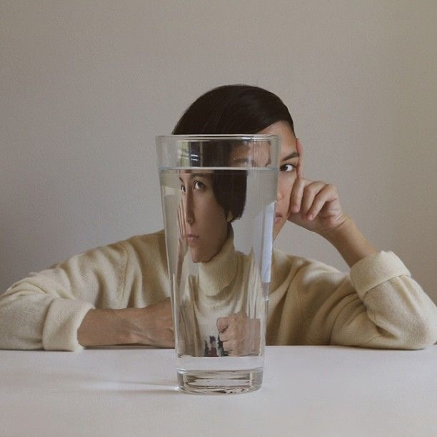
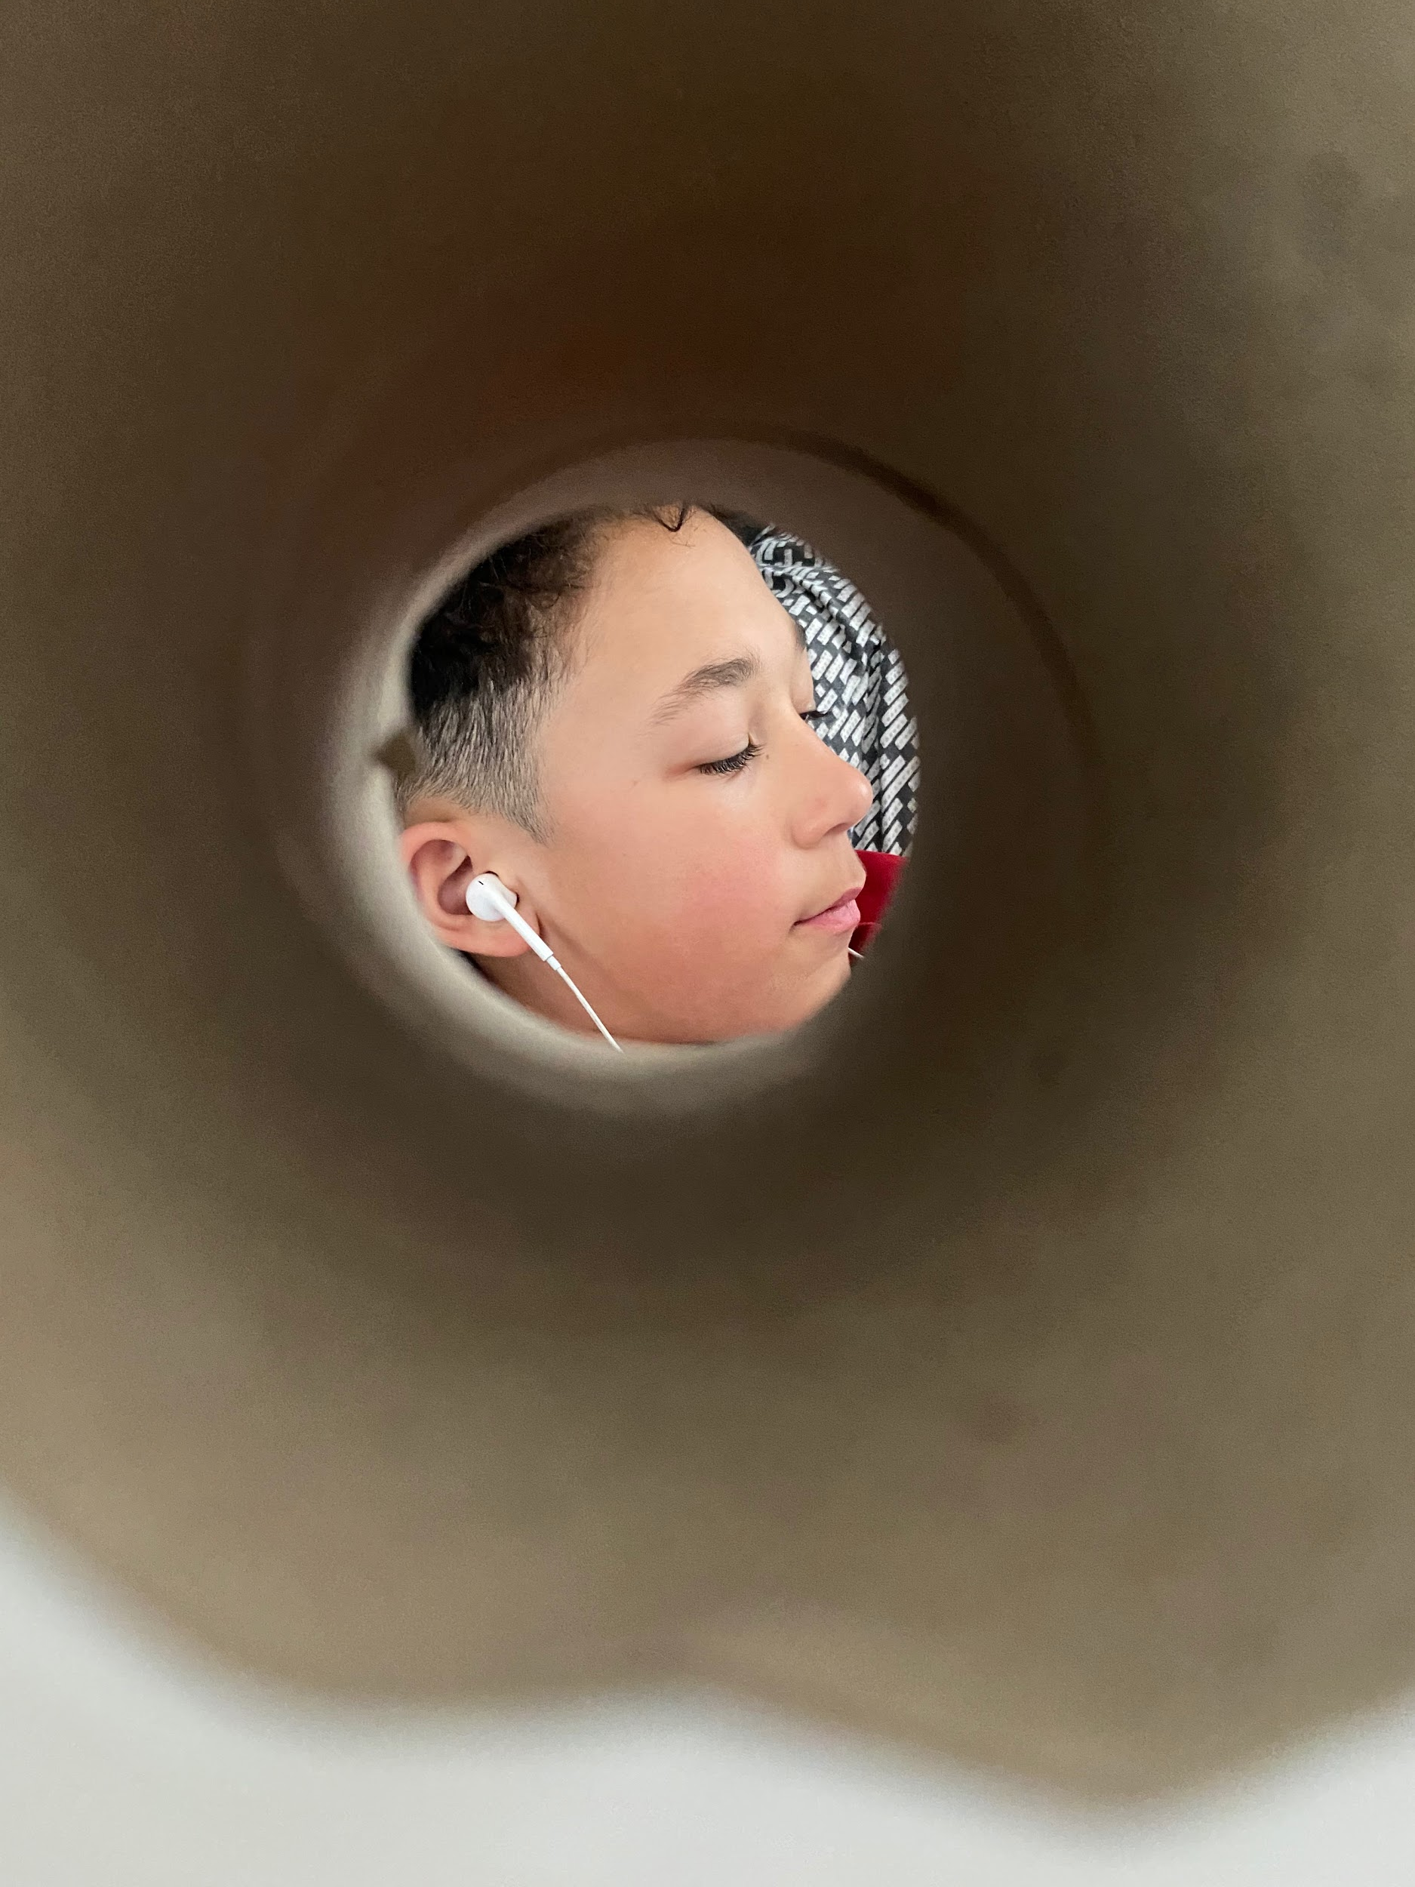
Experimenting with viewfinders -week 2 lesson 7
Task!
Task!
Present your images in your work on Google slides if you can. You will need google chrome and need to create an account with an email address. Use the waffle icon on the right to locate google slides- it works a lot like Powerpoint- I have been learning new things myself!
Use the title “ experimenting with viewfinders” and annotate your work to explain what your did and which images you like best and why.
Something from your garden
Something square
A view finder gives us a defined shape through which we compose or see our image.
Your task is take a series of experimental photographs of someone at home using the following items to shape or define your view!
Take photographs using each of the following as inspiration for your viewfinder ...
A plastic bottle
Something paper
Something round
Something glass

