Slide 1
Lo: to be able to identify characteristics of the work by Sasha Ray.

Slide 2
Task:
Create a research slide/document/google slide/page on paper, on the artist Sasha Ray.
Include:
Title: artist’s name
Images of her work on Manchester (look for the ones which include images of buildings)
Information on the style of the artists work.
There is helpful hints on the next slide and a link to her website below:
https://sasharayart.com/

Slide 3
Elements of Sasha Ray’s work: Look at these points to understand about the composition of her work.
The backdrop here is made up of lots of Manchester architecture that has been made as a montage.
The Manchester’s bee emblem used as an overlay over a backdrop of imagery based on Manchester.
A white banner section of the composition highlights text which describes Manchester by Tony Wilson.

Slide 4
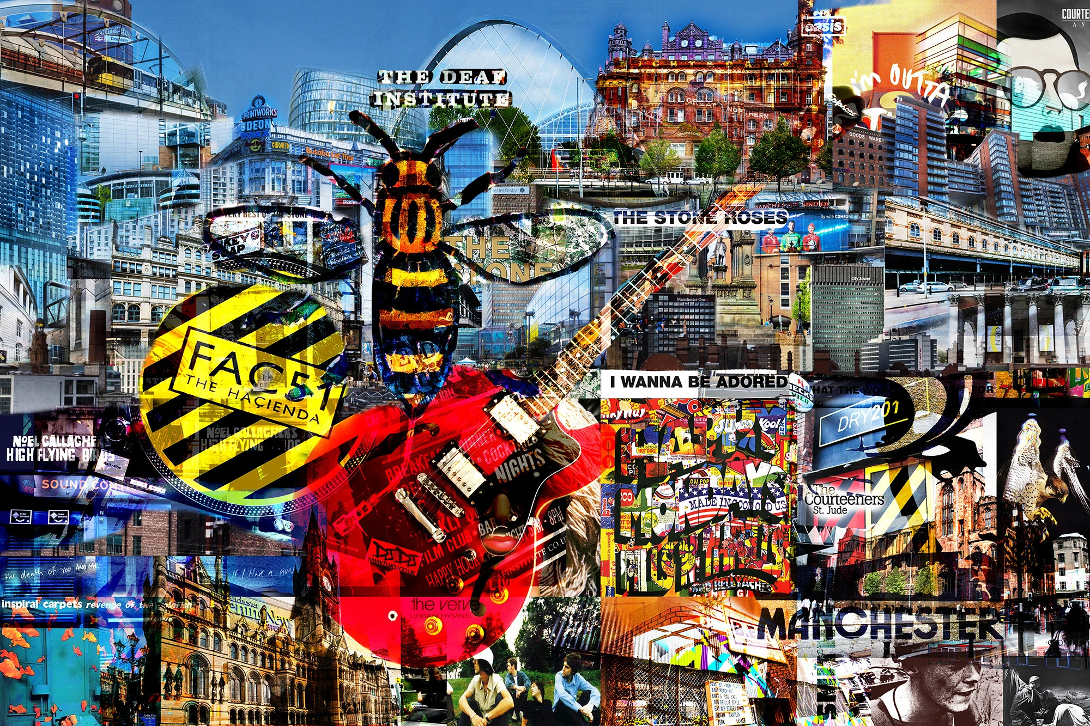
Make sure you collect images of her work that feature photographs of the city rather than this type which is more graphic-like.
Sasha Ray also creates overlapping transparency pieces like this:

Slide 5
Help with Annotation:
Sasha Ray’s work is about celebrating elements of Manchester, she creates commissions for people as well as companies therefore she personalised work to suit the brief.
The characteristics of the artist’s work are …………………………………..and ………………………………………………………………….together with the addition of……………….
I aim to include these characteristics in my own work by……………………………………………………………………………………..for the text element, I aim to use lines from ………………………...

Slide 6
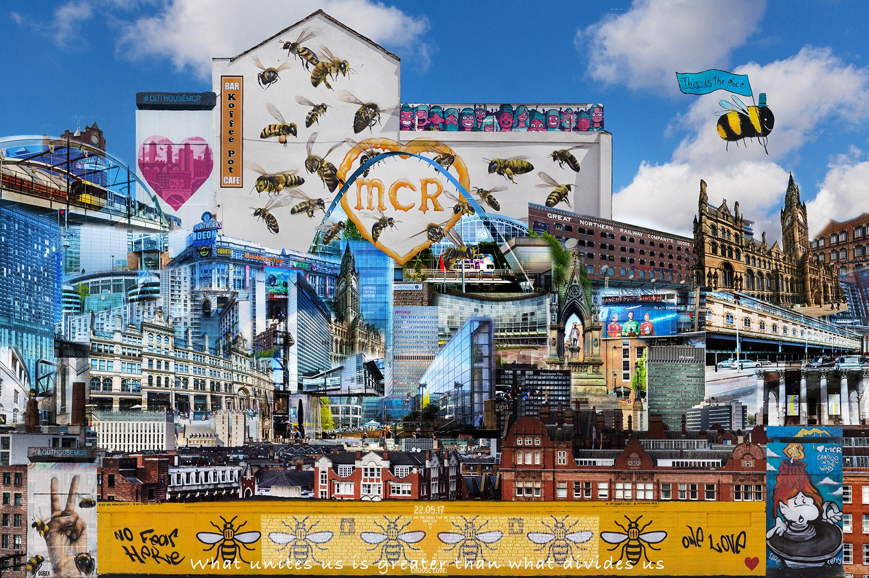
We will build up a “city” from building images which has layers and depth in the style of SASHA RAY, a bit like these when we are back at school.

