Slide 1
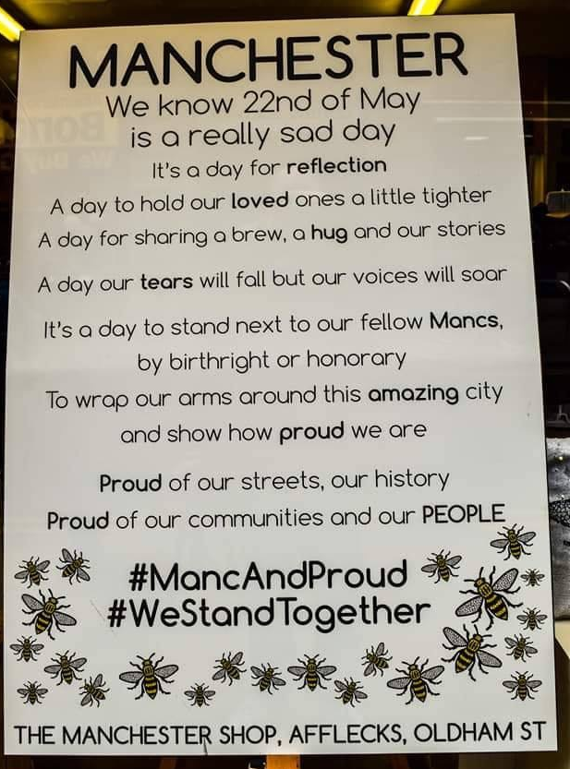
LO: to develop understanding of why the bee is an emblem of Manchester.
After the Manchester Arena attack on 22nd May 2017, many people used the bee symbol as a emblem for solidarity and Mancunians.
The bee has long been a symbol for Manchester and it’s people long before the attack.

Slide 2
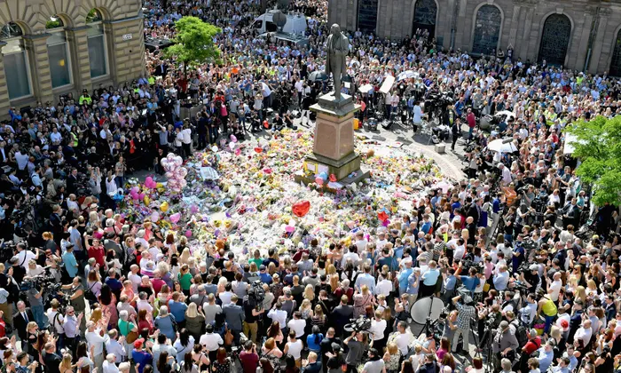
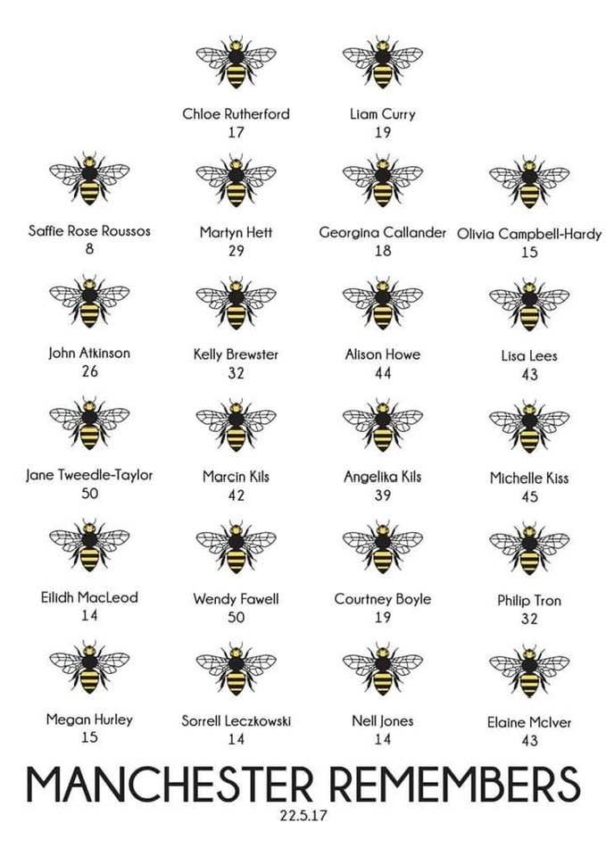
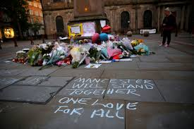

Slide 3
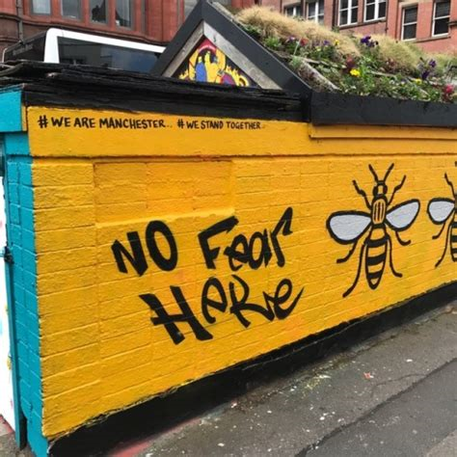
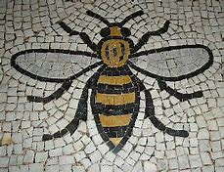
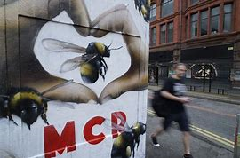
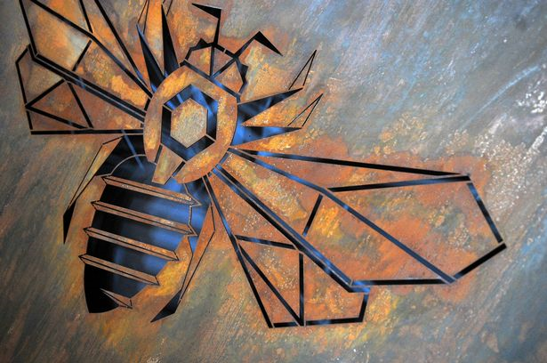
Task: you can complete this on google slides, word, powerpoint or paper, though if you can, digitally would be best so we can add it to your portfolio without typing it up.
Research the Manchester Bee emblem:
Why is it a symbol for Manchester?
What did it relate to?
Where can it be found (historically)
Can you use the internet to find contemporary versions of it? Photos, artwork, graffiti?

Slide 4
The Bees still Buzz by Ryan Williams.
A grey Tuesday morning, 'neath Lancastrian skies We wake once again to wipe tears from our eyes. Forced to wear robes of weakness ad pity, As cowards attack the very heart of our city. Like always, we'll comfort and hold one another, A Mancunian family of sisters and brothers. For a time our strut is reduced to a stagger, But make no mistake, we'll rekindle our swagger. We'll learn how to live with another deep scar. If you think you can beat us, you don't know who we are! We're Collyhurst, Ancoats, Moston and Sale. We're Oldham and Bury; Ashton; Rochdale.
We're a city of workers, a city of shirkers. A city of tracksuits, and bibles and burkas. Vegetarian, Rastafarian, Athiest, Jew. 100 red! 100% blue. We're each of us different but never alone. In the Cosmopolitopia, we get to call 'home'. So, come at us again, and again if you must. Time after time we'll rise from the dust. You'll never prevail - not against us... This is Manchester, our MANCHESTER And the bees still buzz!
Watch:
https://www.youtube.com/watch?v=WQ8pckytSH8

Slide 5
What does the first line of this part of the poem describe Mancunians to be? Why?
Explain how the use of language in this line implies unity amongst Mancunians.
Like always, we'll comfort and hold one another, A Mancunian family of sisters and brothers. For a time our strut is reduced to a stagger, But make no mistake, we'll rekindle our swagger.
Can you find another line in the poem that reiterates resilience of Mancunians?
Explain and Describe how the poet depicts the resilience in the people here use this last sentence to explain your answer.

Slide 6
Task:
Explain what the quote from the poem is trying to get across about the people of Manchester.
Include in your answer:
What workers and shirkers are,
Explain what the clothing descriptions are alluding to.
100% red! 100% blue. means
“We're a city of workers, a city of shirkers. A city of tracksuits, and bibles and burkas. Vegetarian, Rastafarian, Atheist, Jew. 100% red! 100% blue.”

Slide 7
Task:
Find a map of Greater Manchester and circle:
Explain why the poet uses the line (quoted on the left)
To help structure:
The writer of the poem in the line “We're Collyhurst, Ancoats, Moston and Sale. We're Oldham and Bury; Ashton; Rochdale.” used this to show…………………………………………………………………………………………………………………………………………
“Collyhurst, Ancoats, Moston and Sale. We're Oldham and Bury; Ashton; Rochdale.”

Slide 8
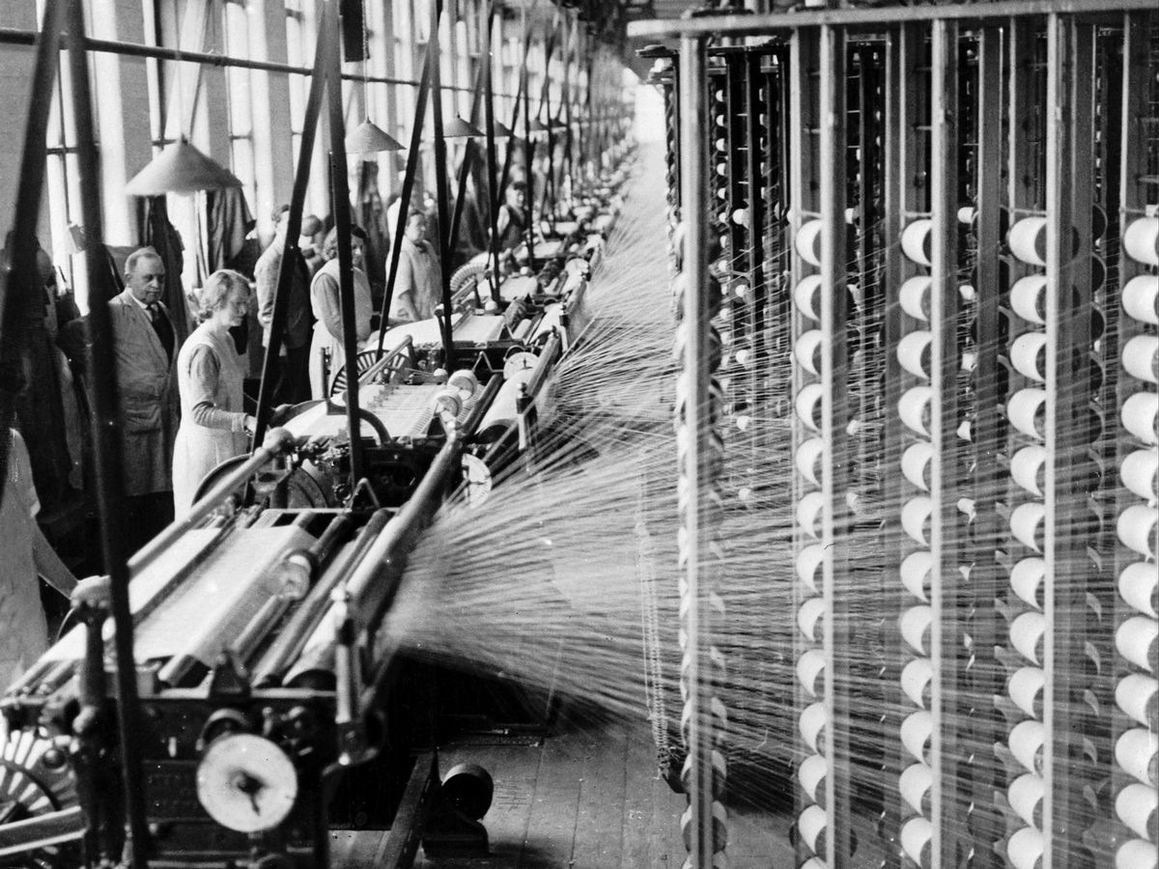
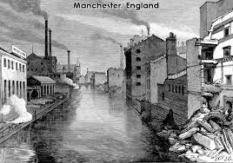
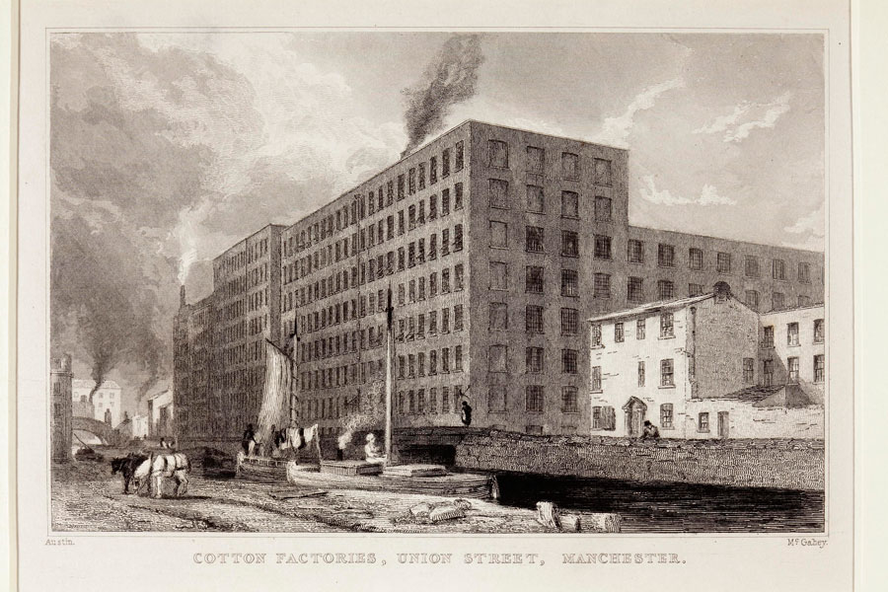
LO: to develop understanding of the Manchester Industrial Revolution.
How Manchester became Great.
Watch the following clip to understand a little about the Industrial Revolution and how it affected Manchester as a Place.
https://www.youtube.com/watch?v=xfX0HjkGFnk&list=PLPYtcpe9UZ9NeGsfjA52_gzjpfY1PiJp7&index=1
How does the Manchester bee relate to the Industrial revolution?

