Slide 1
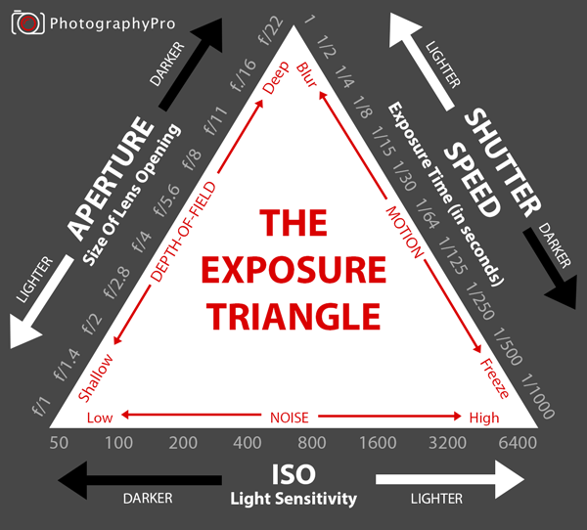
ISO Setting.
ISO setting is one of the three elements which affect exposure when taking photographs.
ISO is simply a camera setting that will brighten or darken a photo.

Slide 2
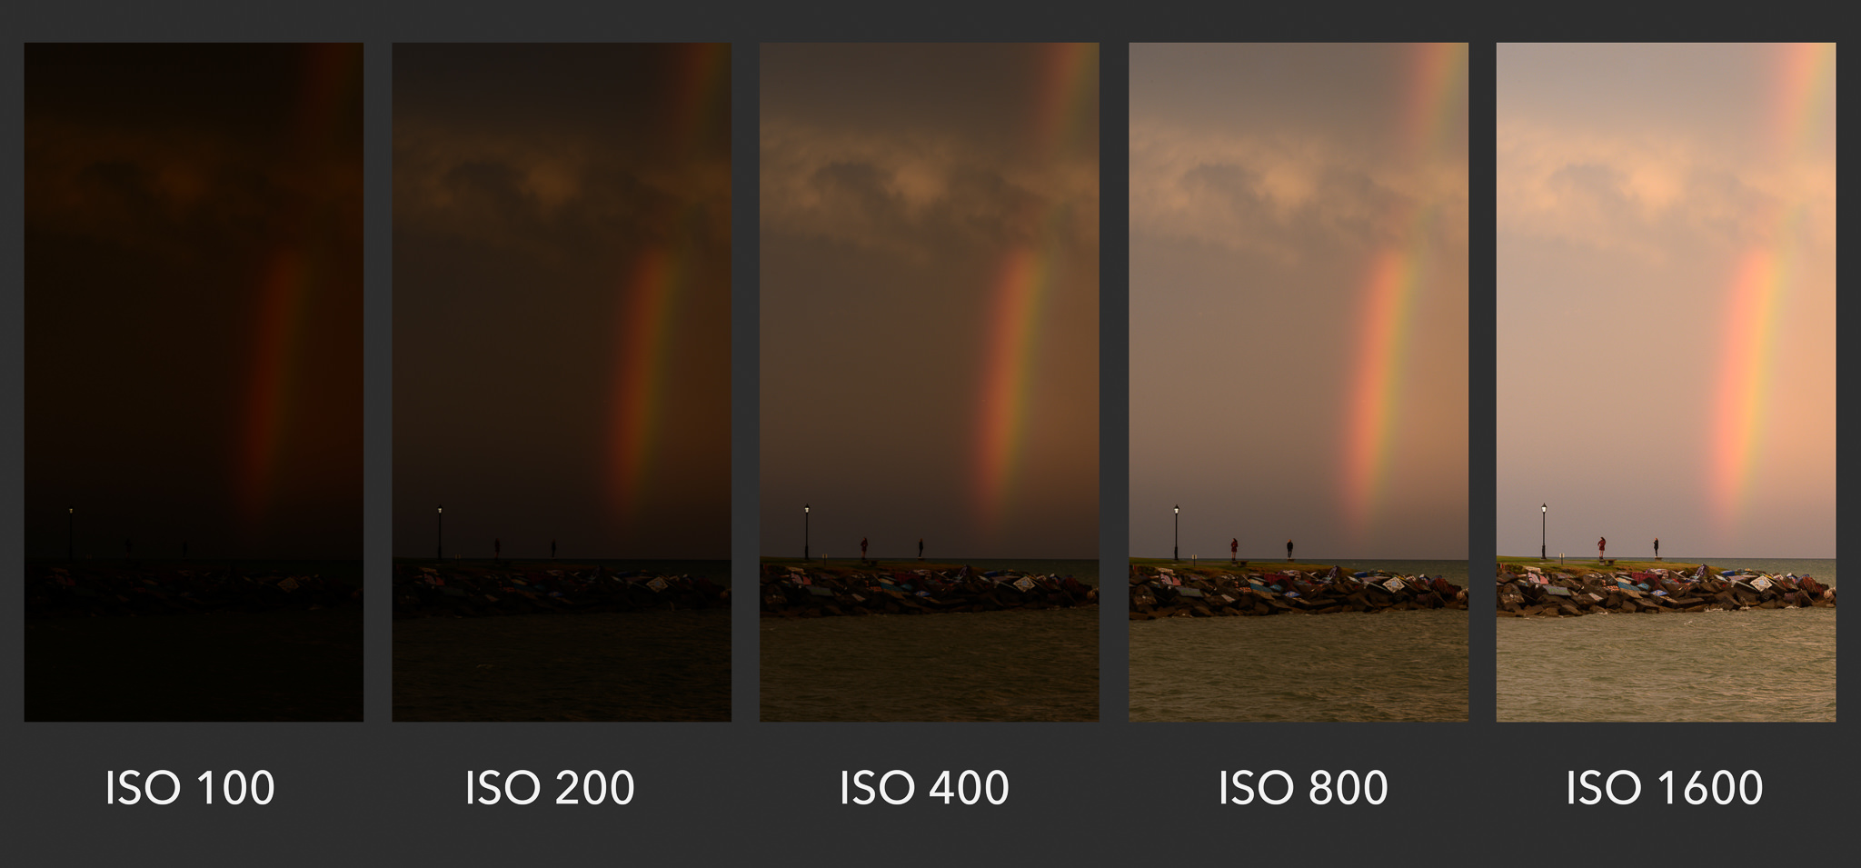
The higher the ISO setting, the less amount of light needed to achieve the correct exposure.
The lower the ISO setting, more light is needed to achieve correct exposure.
As you increase your ISO number, your photos will grow progressively brighter.
For that reason, ISO can help you capture images in darker environments, or be more flexible about your aperture and shutter speed settings.
ISO initially defined only film sensitivity, it was later adopted by digital camera manufacturers with the purpose of maintaining similar brightness levels as film.

Slide 3
However, raising your ISO has consequences. A photo taken at too high of an ISO will show a lot of grain, also known as noise, and might not be usable. So, brightening a photo via ISO is always a trade-off. You should only raise your ISO when you are unable to brighten the photo via shutter speed or aperture instead (for example, if using a longer shutter speed would cause your subject to be blurry).

Slide 4
Understanding “grain” or “noise”
Here is an example of two photos taken at different ISO values.
Look at the comparison.
Pay attention to the level of noise (graininess and blotchy colors) in the images:
The difference is clear – the image at ISO 3200 has much more noise than the one at ISO 200 (which was brightened with a long shutter speed instead).
This is why you should avoid high ISOs whenever possible, unless conditions require you to use them.

Slide 5
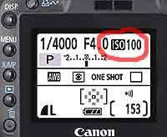
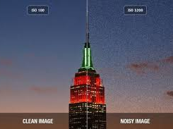
You should always try to stick to the lowest ISO (base ISO) of your camera, which is typically ISO 100 or 200, whenever you can. If there is plenty of light, you are free to use a low ISO and minimize the appearance of noise as much as possible.
Even in dim or dark environments, you still might be able to use a low ISO. For example, if you have your camera mounted on a tripod or sitting completely still on a table. In that case, you can safely use a low ISO and brighten your photo via a long shutter speed instead, since you won’t introduce camera shake.

Slide 6
Is ISO Part of Exposure?
No, ISO is not part of exposure. Shutter Speed and Aperture brighten your photo by physically capturing more light. ISO doesn’t do that; instead, it essentially brightens the photo you already captured. So, photographers don’t consider it to be a component of exposure.
Watch this:
https://www.youtube.com/watch?v=mB4xLIz27ts
What is the Best ISO Setting for Low-Light?
When shooting in low-light conditions, your shutter speed will typically decrease, resulting in camera shake or motion blur. To avoid such issues, you should increase ISO setting to a higher value, such as ISO 1600.

Slide 7
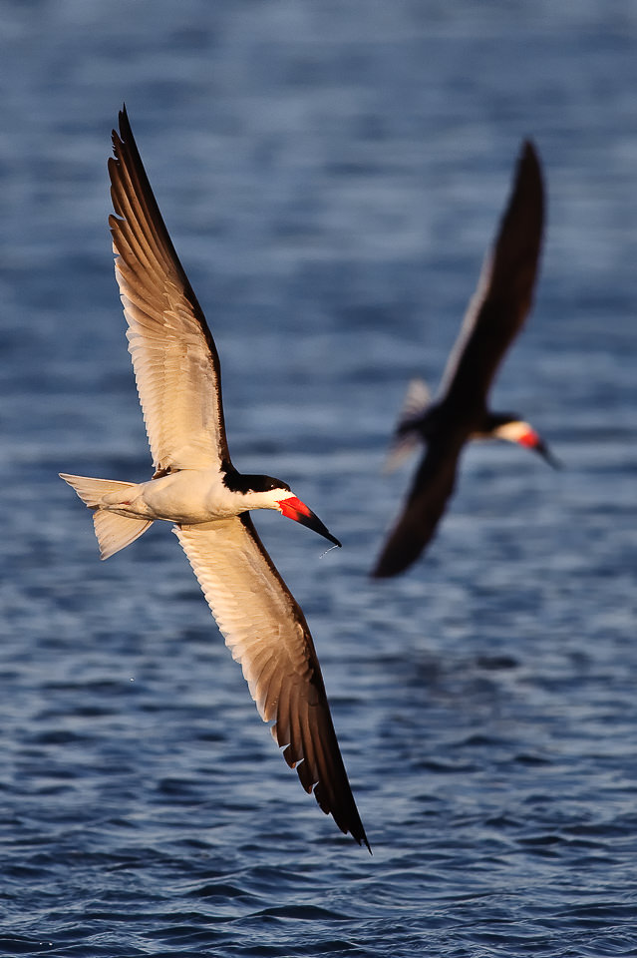
Example:
Even though it is ideal to use low ISOs, there will be plenty of times when a high ISO is necessary in order to take a good photo in the first place. The simple reason is that you are often fighting against motion blur, and you will need to pick between a sharp photo at a high ISO, or a blurry photo at a low ISO.
This image captured these Black Skimmers at 1/2000th of a second and ISO 800. Here, the camera needed 1/2000th of a second to fully freeze the birds while they were in flight.
What would have happened if the camera had been set at ISO 100 instead? It would have needed a shutter speed of 1/250th of a second to capture a bright photo.
At that setting, there would have been a lot of unwanted motion blur in the picture, since the birds were moving so fast. In short, the image would have been ruined.
An image of Black Skimmers captured at ISO 800 and 1/2000 shutter speed

