Slide 1
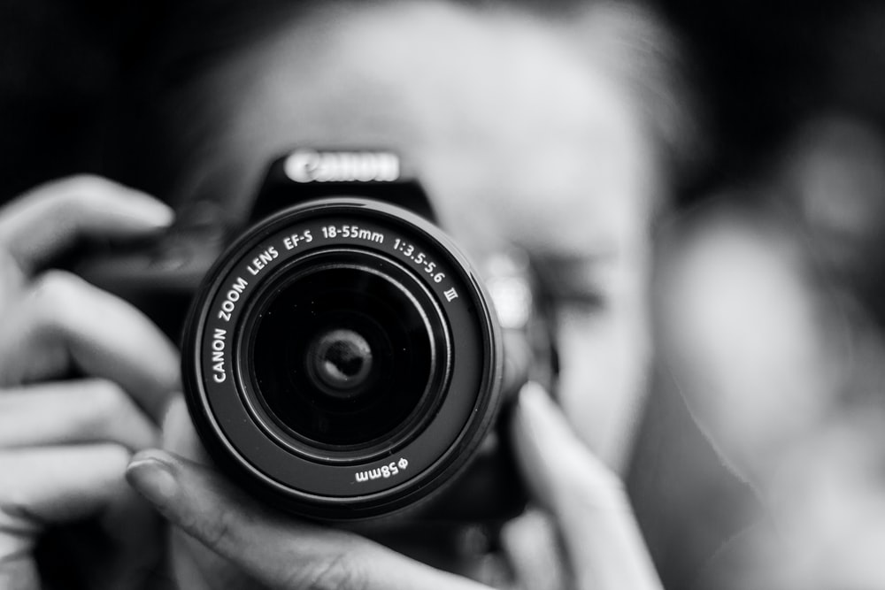
During this time, I will be setting work on Photography skills and also our topic for Summer term.
Our Topic for Summer term is Manchester: “This is the Place”.
It incorporates Photography with Design in the style of a brief which uses Poems as a stimulus.
The project will develop your understanding of Photography skills and editing together with your skills of analysis and using imagery to communicate with others.
Throughout skills based work you will be exploring the technical side of photography and general knowledge of the subject to enhance your own work and ideas.

Slide 2
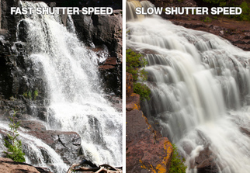
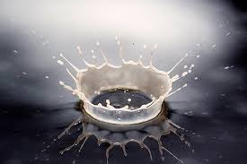
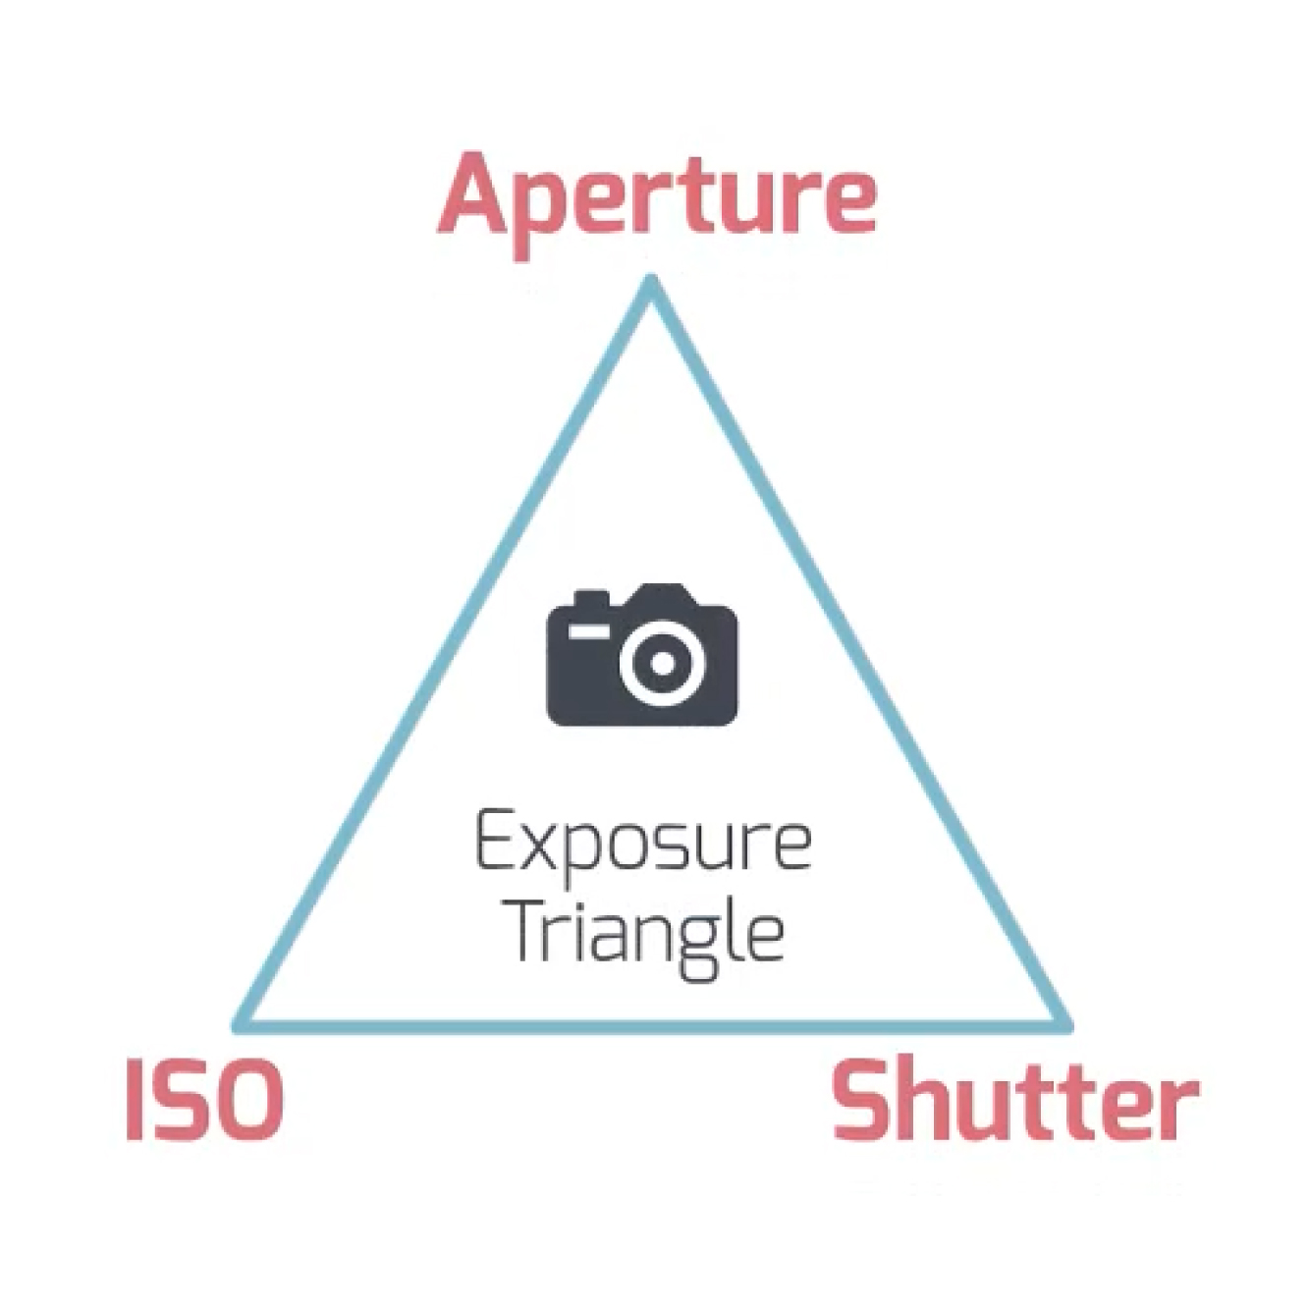
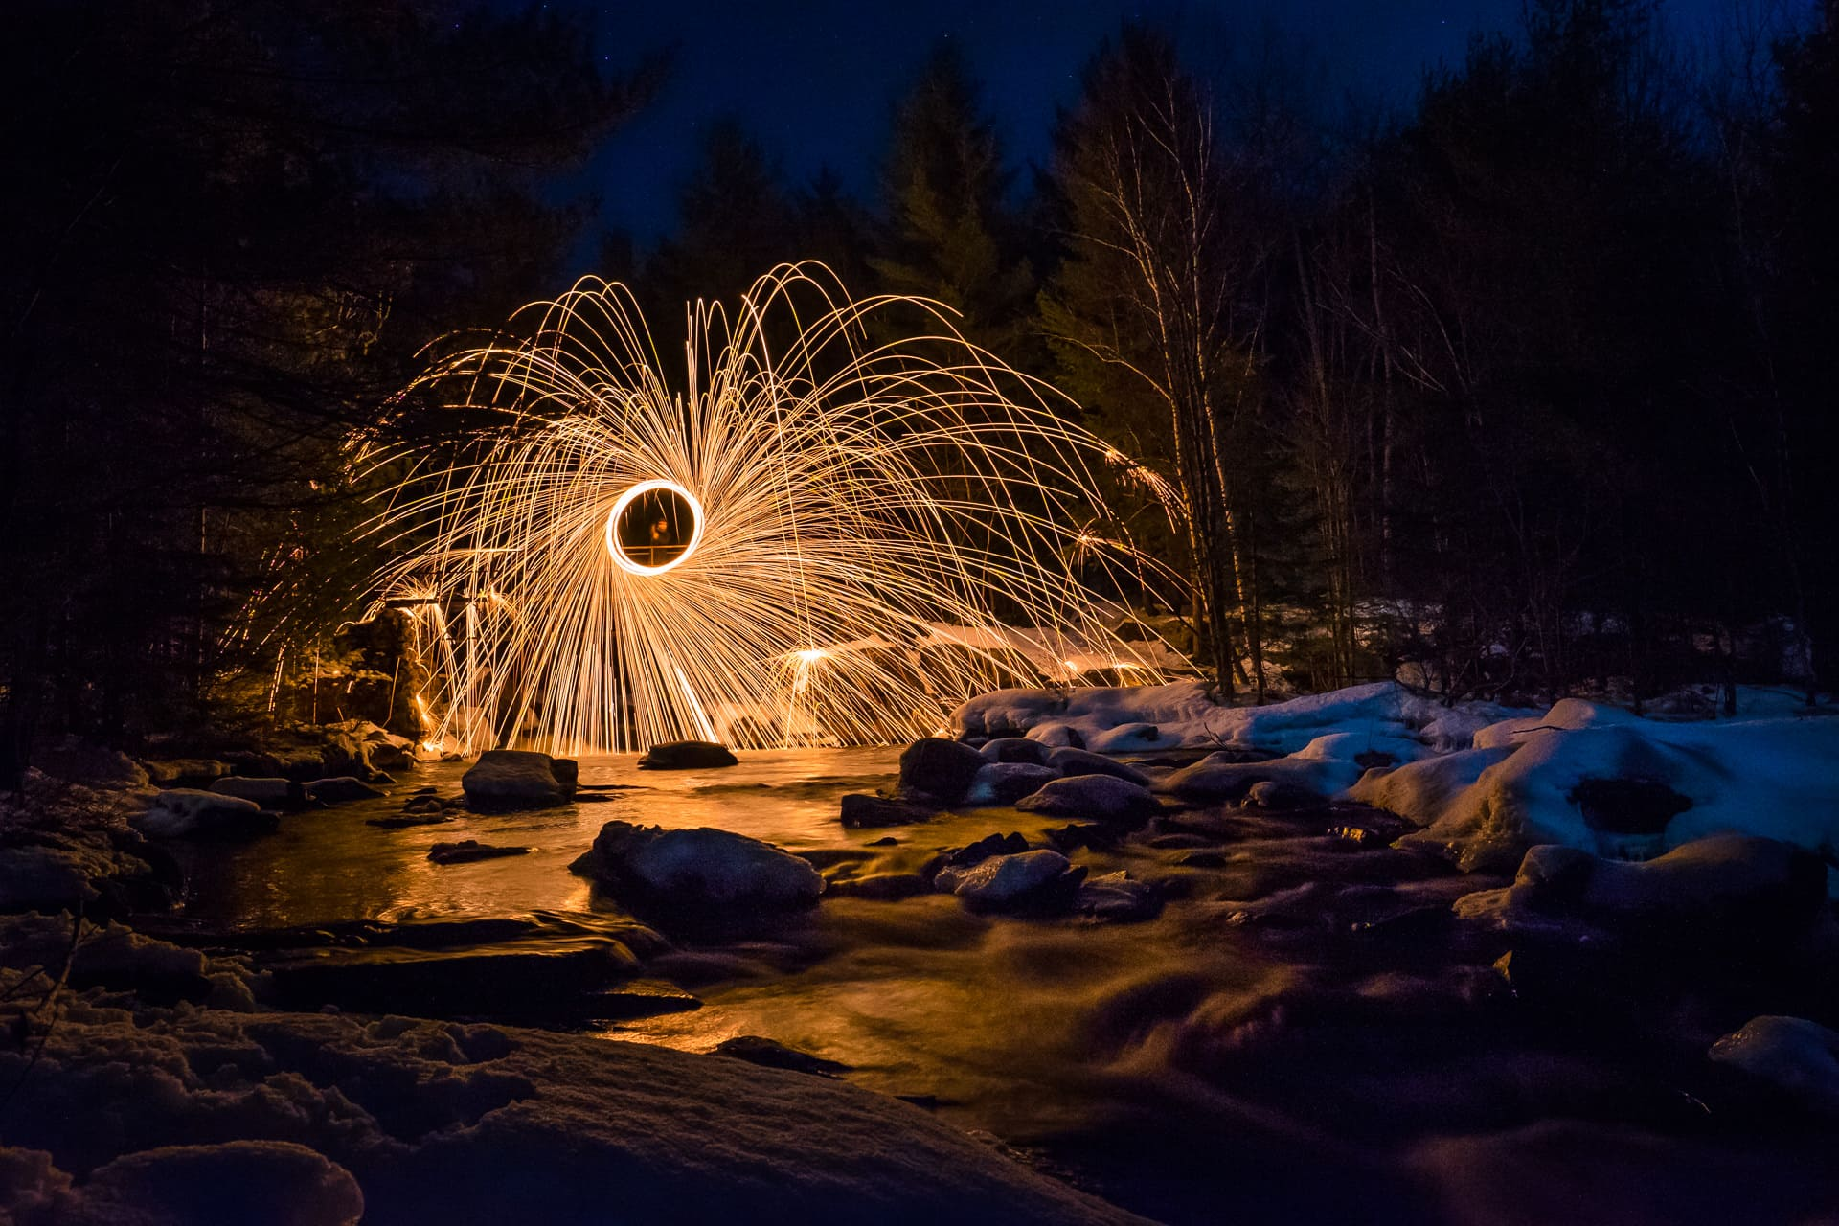
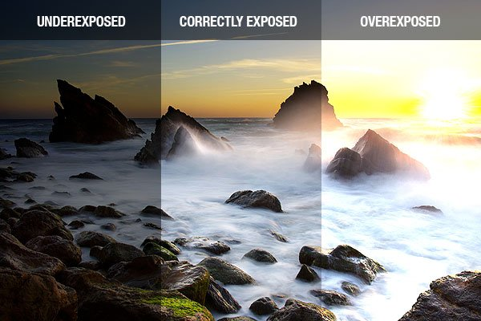
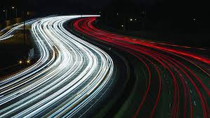
Exposure in Photography
Fast shutter speed
Slow Shutter Speed
https://www.youtube.com/watch?v=6CEH_31K6YU
Examples of Exposure

Slide 3
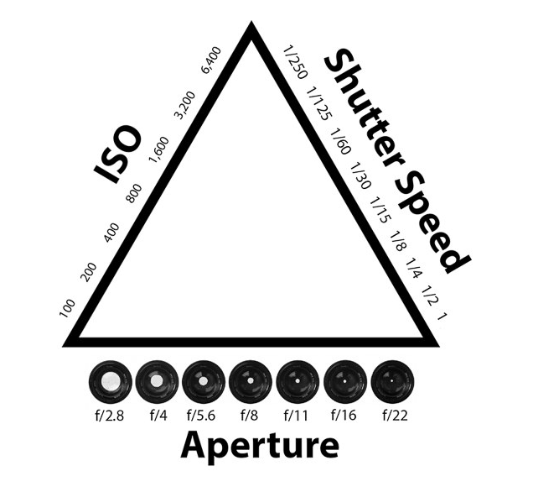
The amount of light that reaches your camera’s sensor affects the exposure of your image.
Basically, a well exposed image is one that doesn’t contain too much white (overexposed), or black (underexposed). There are three things that influence the “brightness” of an image in any given level of light
This can be controlled by three settings on your camera that work in unison:
ISO: the sensitivity of the light sensor.
Aperture (Measured in F stops).
Shutter speed (measured in seconds or fractions of a second).
What is Exposure?
Exposure in Photography relates to the amount of LIGHT needed to create your photograph.
This diagram, known as the Exposure Triangle, shows how all three settings relate and are affected by one another. If you change one of the settings, the others will be impacted (and at times need altering) to achieve the correct exposure.

Slide 4
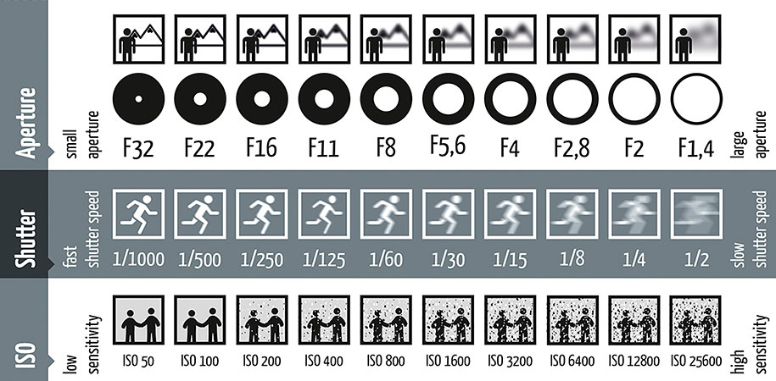
The shutter speed settings have the ability to freeze or blur your image. The LONGER the time in seconds, the slower the shutter opens and closes.
As you can see, the F stop or Aperture, affects the distance of the depth of Field. The SMALLER the NUMBER, The Shorter the Depth of Field, so the more blurred the background.
ISO setting: the lower the ISO number, the lower the sensitivity which can produce clearer images.

Slide 5
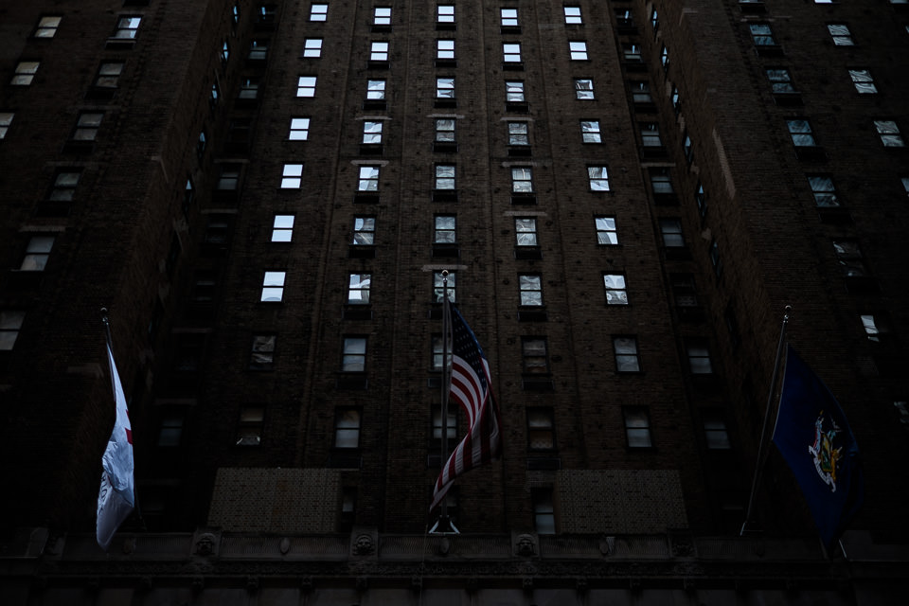
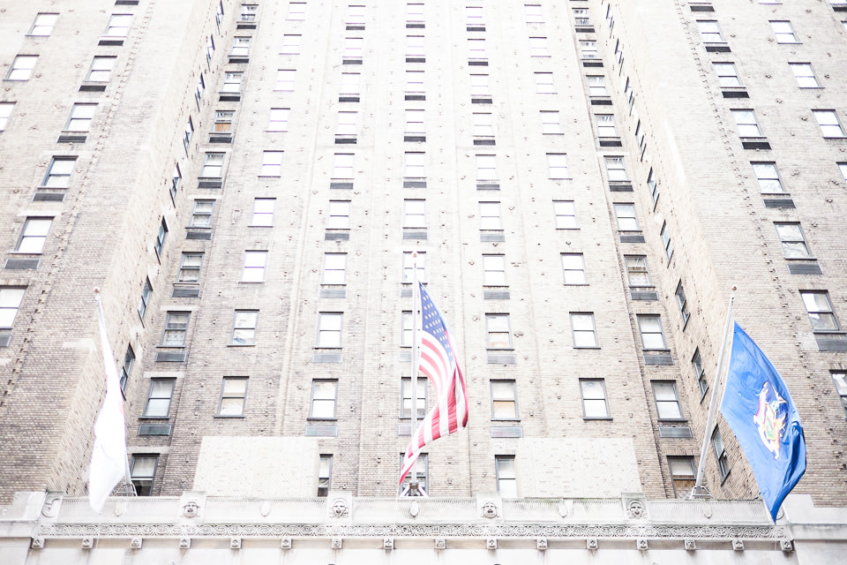
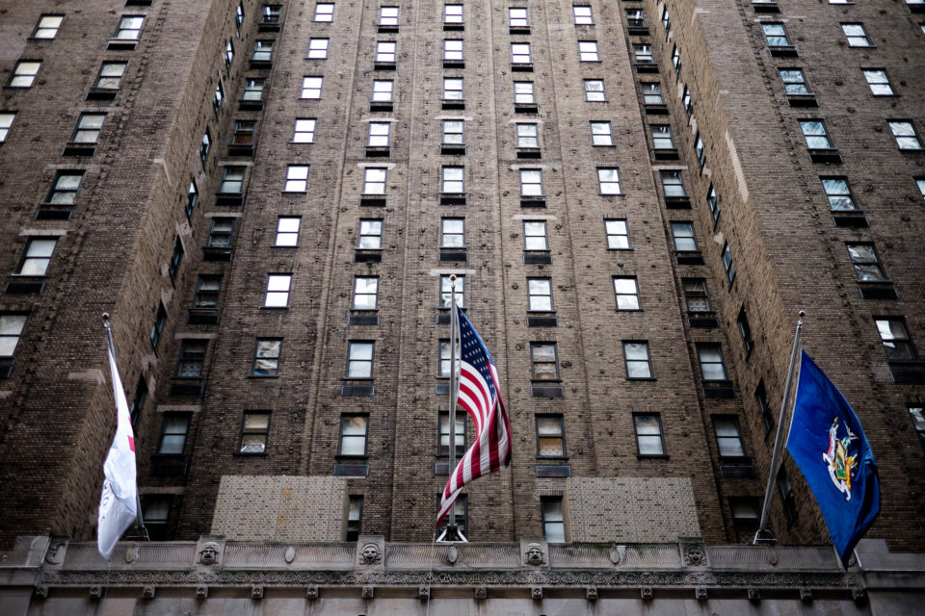
When trying to achieve a “correctly-exposed” image, what matters is not the settings you choose, but their correlation, as each of the three individually have an effect on the said brightness.
So, for example, if you are in a brightly-lit environment and choose to use a wide aperture setting (maybe f/2 or f/1.4), you will need to compensate it with a faster shutter speed and/or lower ISO sensitivity value.
Should you make a mistake and get the correlation between the settings “wrong”, you will end up with an image that is not exposed “correctly”.
Identify from these images, which is overexposed, under exposed and correct exposure.

Slide 6
Watch these clips on the Exposure Triangle and shutter speeds
https://www.youtube.com/watch?v=6CEH_31K6YU
https://www.youtube.com/watch?v=g6DIaFnnCiI
https://www.youtube.com/watch?v=1wHtRelnbRk

