Slide 1
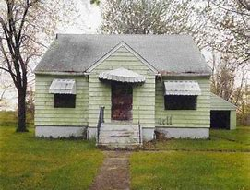
518 101st street, Love Canal Neighbourhood. Niagara Falls, New York, 1994 by Joel Sternfeld.
This photo as named above reveals a much more challenging history than you might expect.
Find out the history of the house in the photograph.
What do you think about Hooker chemical Corporation and their contract of sale?
Use the case of Lois Gibbs to help you find out more.
The film “Erin Brockovich” is based on this real life story- see if you can watch it.

Slide 2
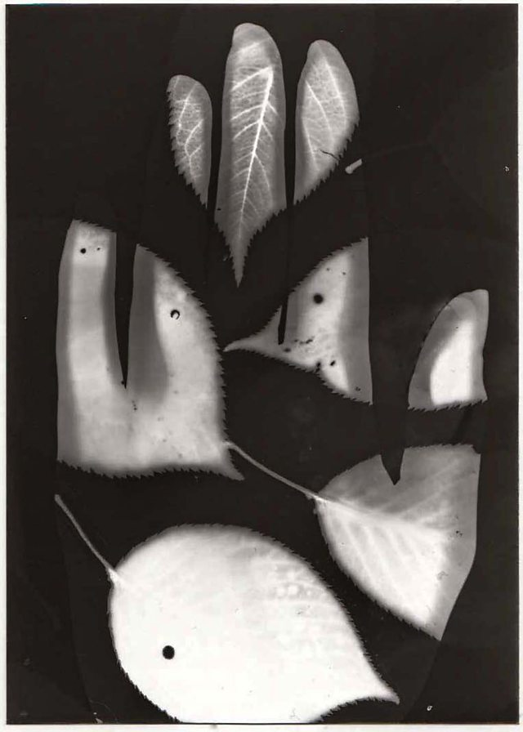
Research
Your notes can be on paper or on a word or Powerpoint document.
Find and make notes on:
What is a Photogram?
Describe how to make a photogram in step by step instructions.
What is a Cyanotype?
Write step by step instructions.

Slide 3
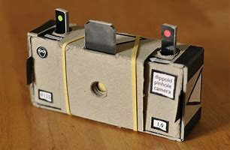
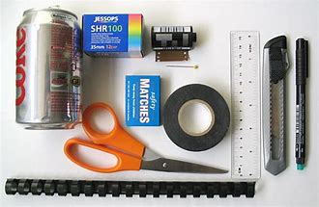
Learn how to:
Learn how to make a pinhole camera.
Create a factsheet on how a pinhole camera works and step by step instructions on how to make one.

